Slide 1
Histograms of Oriented Gradients for Human Detection
Navneet Dalal
Bill Triggs
INRIA Montbonnot
Marion Millien-Lepine
Chamara Jayalath
M2R Mosig

Slide 2
Introduction
Human detection based on Histogram Oriented Gradients (HOG).
Different approach in using HOGs.
Extended to other object detection.

Slide 3
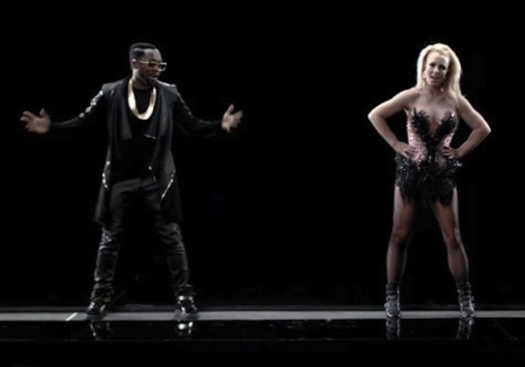
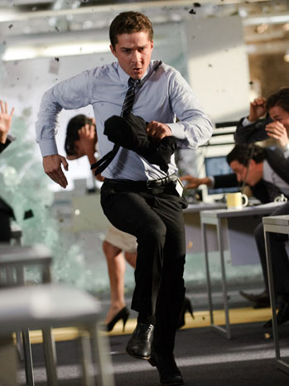
Introduction
Challenging task owing to their variable appearance and the wide range of poses.
Robust feature set to discriminate the human form.

Slide 4
Outline
Previous work
Hog
Method
Dataset and results

Slide 5
Previous work
Papageorgiou’s Haar wavelets as input descriptors.
Gavrila & Philomen uses extracting edge images and matching them using chamfer distance
Viola moving person detector, using AdaBoost on Haar-like wavelets and space-time differences.
And etc………

Slide 6
Outline
Previous work
Hog
Method
Dataset and results

Slide 7
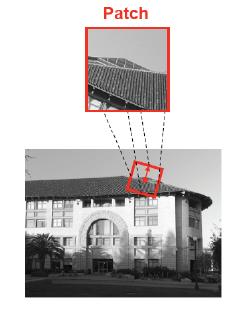
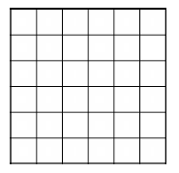
HOG
To discriminate the object form using gradient orientation.
Cell (nxn pixels)
Block(t cells)

Slide 8
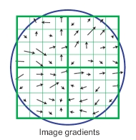
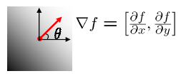
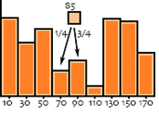
HOG
Find the edge direction at each pixel in a cell.
Count occurrences of gradient orientation in cells.
h(θ) = h(θ) +1 ; for the portion
0 to pi or 0 to 2pi; quantize to N bins
A local histogram for each cell.

Slide 9
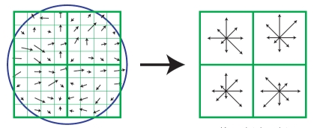
HOG
The collected histograms of cells can be agregated in a defined block
Ex: 0 to 2Pi edge orientations truncated to 16. 4 Cells per Block
Gives 16x4 = 64 features

Slide 10
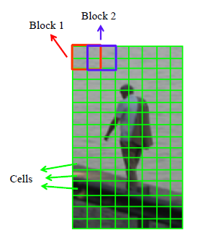
SIFT and HOG in Human Detection
SIFT uses Oriented Gradients to select the feature vectors >> But local
HOG as a dense image descriptor.

Slide 11
Outline
Previous work
Hog
Method
Dataset and results

Slide 12
The method

Slide 13
Normalize gamma/colour
Evaluation of several input pixel representations;
Gray Scale
RGB
LAB
No significant performance change >> subseqent normalizations ? ?
Gray Scale reduces performance
BottomLine : No gamma/color Normalization

Slide 14
Compute gradient
Evaluation 0f gradient computing;
Gaussian smoothing (scale including sigma=0) followed by discrete derivative masks ;
[-1 1] uncentered
[-1, 0 ,1] centered
[1,-8,0,8,-1] cubic corrected
3x3 sobel masks
2x2 diagonal (0 1; -1 0), (-1 0; 0 1)
Using larger masks always decrease performance.

Slide 15
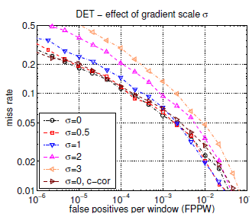
Compute gradient
Simple 1-D masks [-1, 0, 1] at sigma=0 work the best.

Slide 16
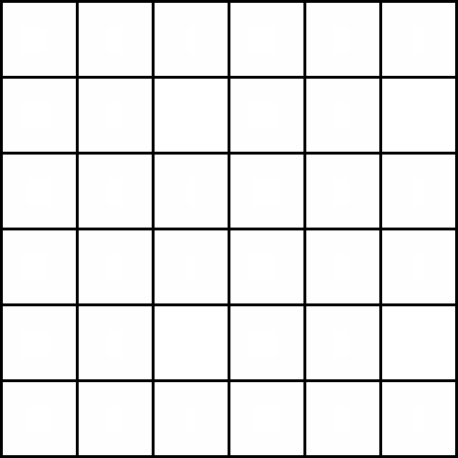
Spatial/Orientation cells
Each pixel calculates a weighted vote for an edge orientation.
Votes are accumulated to the orientation bins over cells.
Orientation bins are evenly spaced from 0-180

Slide 17
Spatial/Orientation cells
Bilinear interpolation between neighbouring bin centers, both orientaion and position.
Ex: if θ=85 degrees.
Distance to the bin center Bin 70 and Bin 90
are 15 and 5 degrees, respectively.
Hence, ratios are 5/20=1/4, 15/20=3/4.
Vote is a function of gradient magnitude.
Why only unsigned orientations?

Slide 18
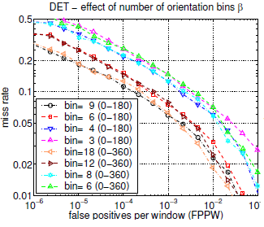
Spatial/Orientation cells
Improvement until 9 bins

Slide 19
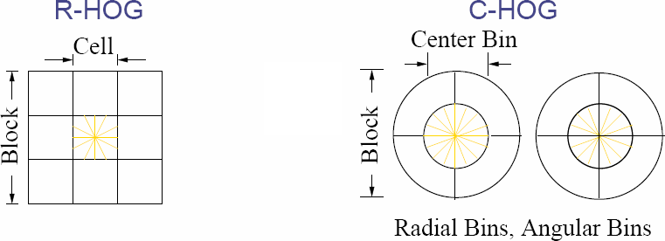
Contrast normalization and descriptor blocks
Illumination
Variance foreground, background
Group the cells in blocks and normalize blocks separately

Slide 20
Descriptor blocks
HOG as global image code.
Cell histograms agregated to Blocks.
Blocks are overlapped.
Is it redundant?
Ex: R-HOG
64x128 image
16x16 blocks 50% overlapped.
Feature Dimension = 3780

Slide 21
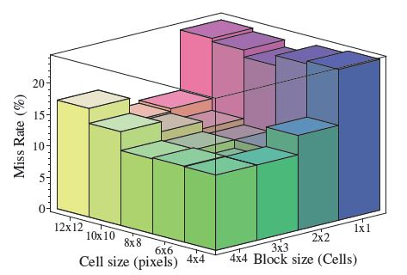
Descriptor blocks
R-HOG
Precise size
Square block
C-HOG
Center divided
Center sample
Same performance
Fine subdivision to work well

Slide 22
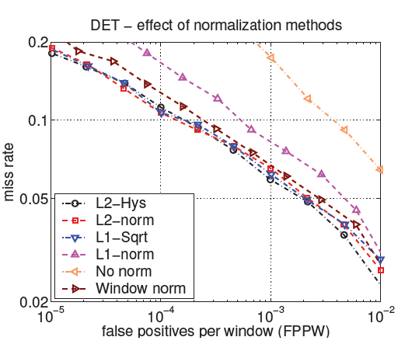
Technics of normalization (Blocks)
L2-norm
L2-Hys
L2-norm, maximize, normalize
L1-sqrt
L1-norm

Slide 23
Technics of normalization (Centered)
Use each cell and its surrounding region
Summed over orientation
Pooled over Gaussian
Performance decreases
Each cell is coded only once in the final descriptor

Slide 24
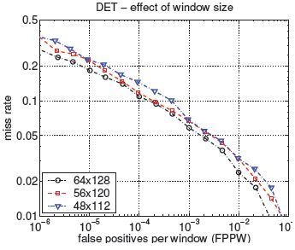
Detector window
16 pixels margin
Decreasing margin decreases performance

Slide 25
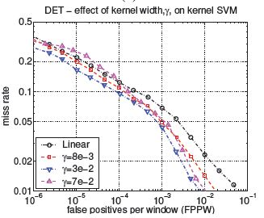
Linear SVM
Linear SVM view in previous presentation
Few modify to use less memory

Slide 26
Implementation and Performance Analysis
Detector has following properties;
RGB Color space with no gamma correction
[-1,0,1] gradient filter with no smoothing
Linear gradient voting into 9 bins
16x16 pixel blocks with 4 8x8 pixel cells
Gaussian spatial window with sigma=8 pixels
L2 norm block normalization
Block spacing stride of 8 pixels
64x128 detection window
Linear SVM classifier

Slide 27
Outline
Previous work
Hog
Method
Dataset and results

Slide 28
Dataset selection
MIT dataset
‘INRIA’ dataset
200 test images
Front or back view
City scene
Limited range of pose
1805 test images
Any orientation
Wide variety of background
No bias on the pose

Slide 29
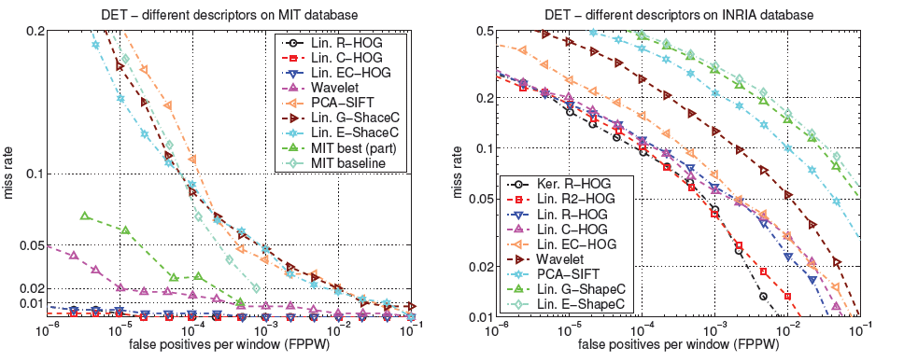
Result
Identify person in all MIT case
Good results in ‘INRIA’ case

Slide 30
Conclusion
Different approach of HOG
Found parameters to obtain good results
Motion information
A part based model

