Slide 1
Visual Categorization With Bags of Keypoints
Original Authors: G. Csurka, C.R. Dance, L. Fan, J. Willamowski, C. Bray ECCV Workshop on Statistical Learning in Computer – 2004 | Presented By: Xinwu Mo Prasad Samarakoon
Notes:
ECCV -

Slide 2
Outline
Introduction
Method
Experiments
Conclusion

Slide 3
Outline
Introduction
Visual Categorization Is NOT
Expected Goals
Bag of Words Analogy
Method
Experiments
Conclusion

Slide 4
Introduction
A method for generic visual categorization
Face

Slide 5
Visual Categorization Is NOT
Recognition
Concerns the identification of particular object instances
Prasad
Xinwu

Slide 6
Visual Categorization Is NOT
Content based image retrieval
Retrieving images on the basis of low-level image features

Slide 7
Visual Categorization Is NOT
Detection
Deciding whether or not a member of one visual category is present in a given image
Face Yes
Cat No

Slide 8
Visual Categorization Is NOT
Detection
Deciding whether or not a member of one visual category is present in a given image
« One Visual Category » - sounds similar
Yet most of the existing detection techniques require
Precise manual alignment of the training images
Segregation of these images into different views
Bags of Keypoints don’t need any of these

Slide 9
Expected Goals
Should be readily extendable
Should handle the variations in view, imaging, lighting condition, occlusion
Should handle intra class variations

Slide 10
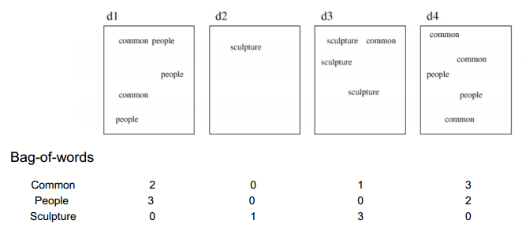
Bag of Words Analogy
Image Credits: Cordelia Schmid

Slide 11
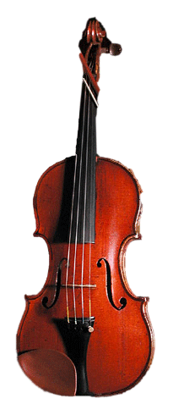
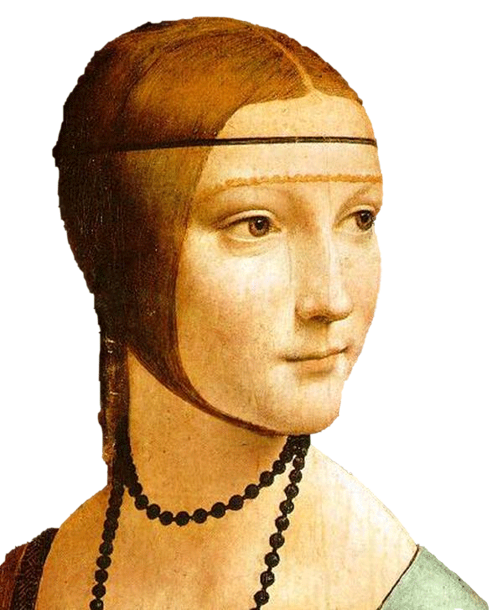
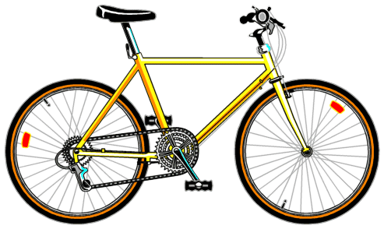
Bag of Words Analogy
Image Credits: Li Fei Fei

Slide 12
Bag of Words Analogy
Image Credits: Li Fei Fei

Slide 13
Bag of Words Analogy
Zhu et al – 2002 have used this method for categorization using small square image windows – called keyblocks
But keyblocks don’t posses any invariance properties that Bags of Keypoints posses
Notes:
They showed that these features produced more “semantics-oriented” results than color and texture based approaches, when combined with ana-logues of the well-known vector-, histogram-, and n-gram-models of text retrieval.

Slide 14
Outline
Introduction
Method
Detection And Description of Image Patches
Assignment of Patch Descriptors
Contruction of Bag of Keypoints
Application of Multi-Class Classifier
Experiments
Conclusion

Slide 15
Method
4 main steps
Detection And Description of Image Patches
Assignment of Patch Descriptors
Contruction of Bag of Keypoints
Application of Multi-Class Classifier
Categorization by Naive Bayes
Categorization by SVM
Designed to maximize classification accuracy while minimizing computational effort

Slide 16
Detection And Description of Image Patches
Descriptors should be invariant to variation but have enough information to discriminate different categories
Image Credits: Li Fei Fei

Slide 17
Detection And Description of Image Patches
Detection – Harris affine detector
Last presentation by Guru and Shreyas
Description – SIFT descriptor
128 dimensional vector – 8 * (4*4)
Notes:
More invariance means less discrimination
Why real world objects are 3D

Slide 18
Assignment of Patch Descriptors
When a new query image is given, the derived descriptors should be assigned to ones that are already in our training dataset
Check them with
All the descriptors available in the training dataset – too expensive
Only a few of them – but not too few
The number of descriptors should be carefully selected

Slide 19
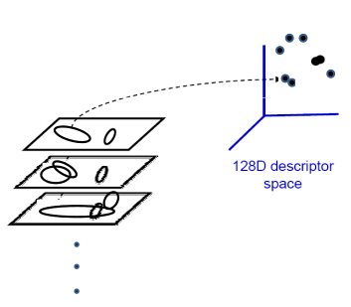
Assignment of Patch Descriptors
Each patch has a descriptor, which is a point in some high-dimensional space (128)
Image Credits: K. Grauman, B. Leibe

Slide 20
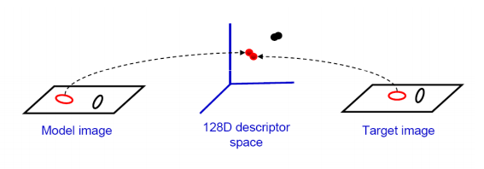
Assignment of Patch Descriptors
Close points in feature space, means similar descriptors, which indicates similar local content
Image Credits: K. Grauman, B. Leibe
Notes:
Vocabulary - say that it’s the number of descriptors per category.
And that it doesn’t have any literal meaning such as nose, eye, mouth in face detection.

Slide 21
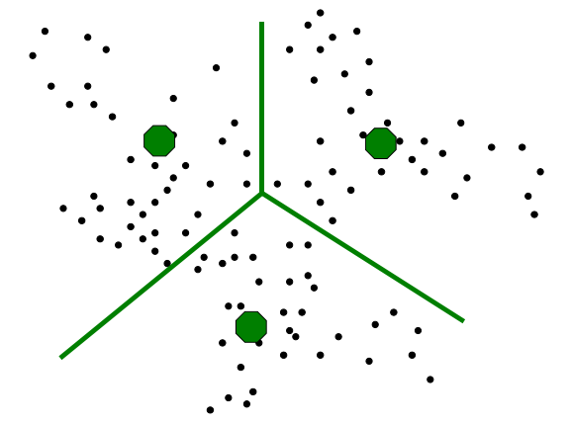
Assignment of Patch Descriptors
To reduce the huge number of descriptors involved (600 000), they are clustered
Using K-means
K-means is run several times using different K values and initial positions
One with the lowest empirical risk is used
Image Credits: K. Grauman, B. Leibe
Notes:
Vocabulary - say that it’s the number of descriptors per category.
And that it doesn’t have any literal meaning such as nose, eye, mouth in face detection.
K-means is done several times using different K values and initial positions
Setting giving the lowest empirical risk is used

Slide 22
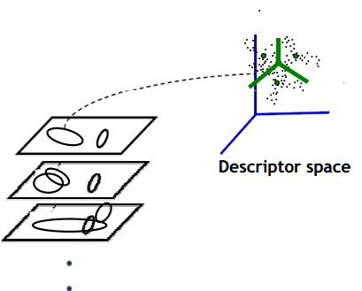
Assignment of Patch Descriptors
Now the descriptor space looks like
Feature space is quantized
These cluster centers are the prototype words
They make the vocabulary
Image Credits: K. Grauman, B. Leibe
Notes:
Vocabulary - say that it’s the number of descriptors per category.
And that it doesn’t have any literal meaning such as nose, eye, mouth in face detection.

Slide 23
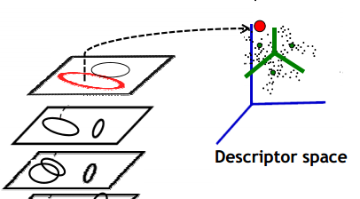
Assignment of Patch Descriptors
When a query image comes
Its descriptors are attached to the nearest cluster center
That particular word is present in the query image
Image Credits: K. Grauman, B. Leibe
Notes:
Vocabulary - say that it’s the number of descriptors per category.
And that it doesn’t have any literal meaning such as nose, eye, mouth in face detection.

Slide 24
Assignment of Patch Descriptors
Vocabulary should be
Large enough to distinguish relevant changes in the image parts
Not so large that noise starts affecting the categorization
Notes:
Vocabulary - say that it’s the number of descriptors per category.
And that it doesn’t have any literal meaning such as nose, eye, mouth in face detection.

Slide 25
Contruction of Bags of Keypoints
Summarize entire image based on its distribution (histogram) of word occurrences
Image Credits: Li Fei Fei

Slide 26
Application of Multi-Class Classifier
Apply a multi-class classifier, treat the bag of keypoints as the feature vector, thus determine which category or categories to assign to the image
Categorization by Naive Bayes
Categorization by SVM

Slide 27
Categorization by Naive Bayes
Can be viewed as the maximum a posteriori probability classifier for a generative model
To avoid zero probabilities of , Laplace smoothing is used
Notes:
P(vt|Cj) – Probability of feature vector vt given category j
Since it’s geometric series, if one term is zero, the result is zero
We can’t have that since then most of these terms will be zero since one visual category will not have all the descriptors present in the dataset
Hence we have to make that value non-zero

Slide 28
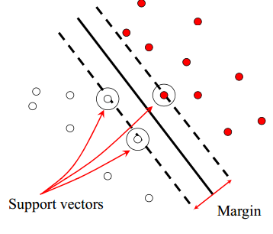
Categorization by SVM
Find a hyperplane which separates two-class data with maximal margin
Notes:
margin = distance of the closest training point to the separating hyperplane

Slide 29
Categorization by SVM
Classification function:
f(x) = sign(w^{T}x+b) where w, b parameters of the hyperplane

Slide 30
Categorization by SVM
Data sets not always linearly separable
error weighting constant to penalizes misclassification of samples in proportion to their distance from the classification boundary
A mapping φ is made from the original data space of X to another feature space
This is used in Bag of Keypoints

Slide 31
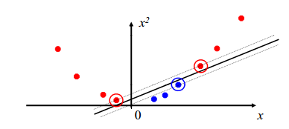
Categorization by SVM
What do you mean by mapping function?

Slide 32
Categorization by SVM
Can be formulated in terms of scalar products in the second feature space, by introducing the kernel
Then the decision function becomes

Slide 33
Outline
Introduction
Method
Experiments
Conclusion

Slide 34
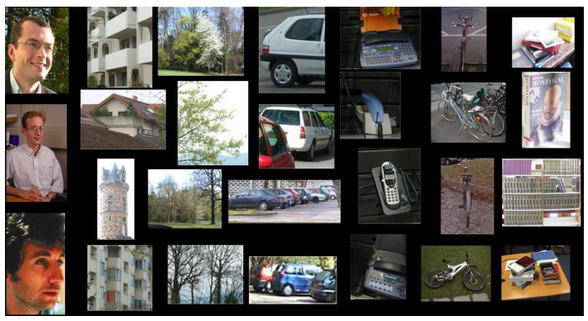
Experiments
Some samples from the inhouse dataset

Slide 35
Experiments
Impact of the number of clusters on classifier accuracy and evaluate the performance of
Naive Bayes classifier
SVM
Three performance measures are used
Confusion matrix
Overall error rate
Mean ranks

Slide 36
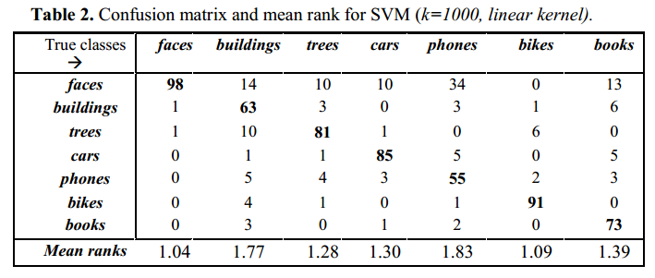
Results

Slide 37
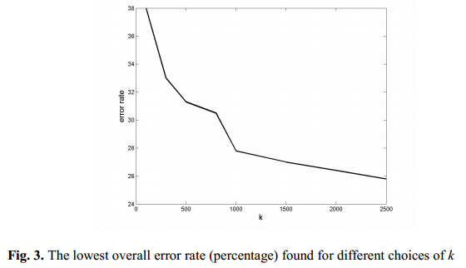
Results
For K = 1000
Naive Bayes 28% SVM 15%

Slide 38
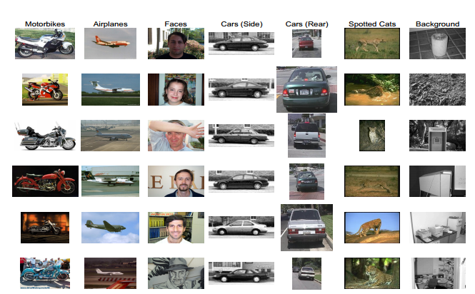
Experiments
Performance of SVM in another dataset
Notes:
Say that the images have minimal background clutter and that they are centered

Slide 39
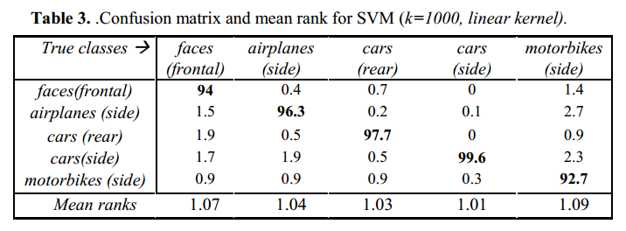
Results

Slide 40
Results
Multiple objects of the same category/ partial view
Misclassifications
Notes:
Say that the images have minimal background clutter and that they are centered

Slide 41
Outline
Introduction
Method
Experiments
Conclusion
Future Work

Slide 42
Conclusion
Advantages
Bag of Keypoints is simple
Computationally efficient
Invariant to affine transformations, occlusions, lighting, intra-class variations

Slide 43
Future Work
Extend to more visual categories
Extend the categorizer to incorporate geometric information
Make the method robust when the object of interest is occupying only a small fraction of the image
Investigate many alternatives for each of the four steps of the basic method

Slide 44
Q&A
Thank You

Slide 46
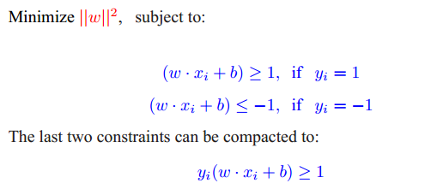
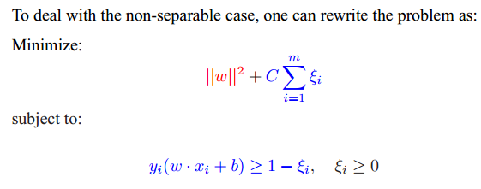

Slide 47
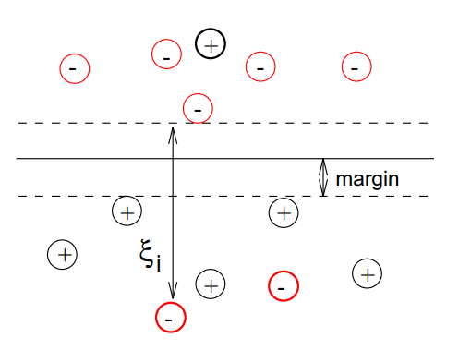

Slide 48
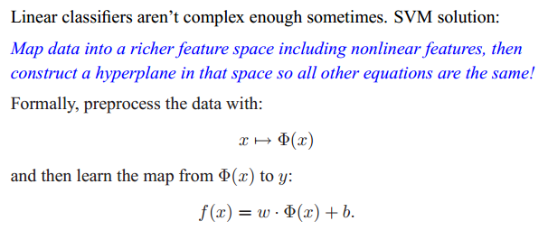

Slide 49
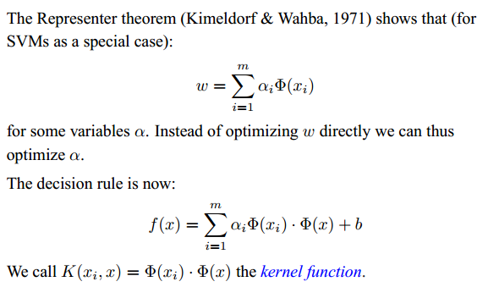

Slide 50
