Slide 1
Weakly supervised learning of MRF models for image region labeling
Jakob Verbeek
LEAR team, INRIA Rhône-Alpes

Slide 2
Outline of this talk
Motivation for “weakly supervised” learning
Learning MRFs for image region labeling from weak supervision
Models, Learning, Results
[Verbeek & Triggs, CVPR 2007], [Verbeek & Triggs, NIPS 2008]
Summary & outlook

Slide 3
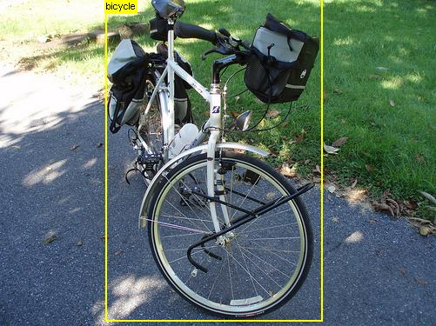
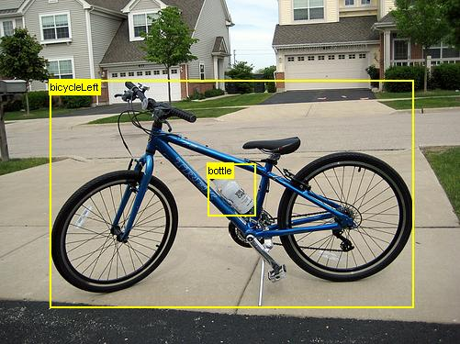
Supervised learning in Computer Vision
Recognition problems in computer vision:
Predict the interpretation y from input image x
Supervised learning from examples
Training set: pairs (x_{i},y_{i})
Learning: maps training set to function y=f(x)
Example: category localization [Harzallah et al ICCV’09]
Winner PASCAL VOC challenge 2008

Slide 4
Learning from weak supervision
Acquisition of training pairs (x_{i},y_{i}) generally costly
Outlining objects, body parts, marking pixels with category labels, …
Motivates work on methods to reduce the need for supervision
Weak supervision: input x + partial knowledge on y
Not as precise as full supervision but lower acquisition cost
Semi-supervised learning: exploits unlabeled inputs x
Learn the subspace or manifold on which input data lives
Active learning: automation of data collection process
Use data labeled so far to determine which data to label next

Slide 5
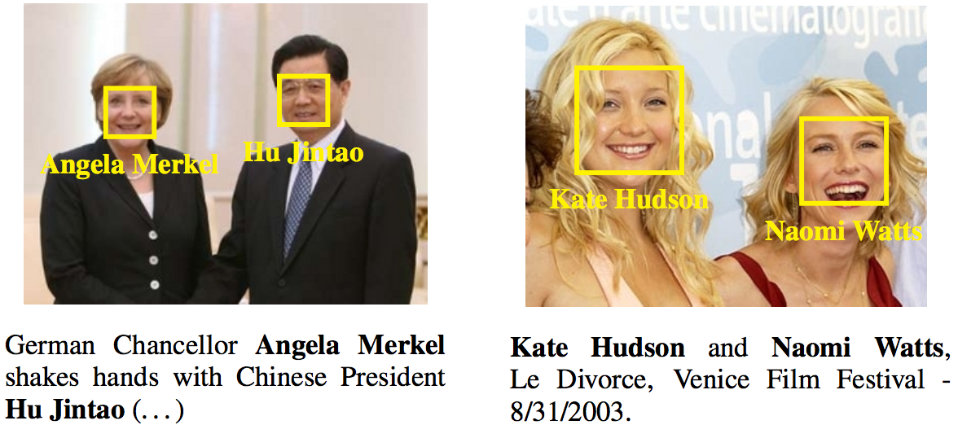
Learning from weak supervision
Face recognition from captioned images [Guillaumin et al, CVPR’08]
No manual labeling of faces with names to learn recognition model
Exploit similarity between faces and name occurrences in captions

Slide 6
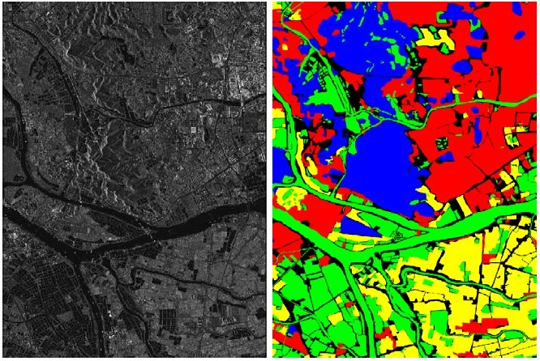
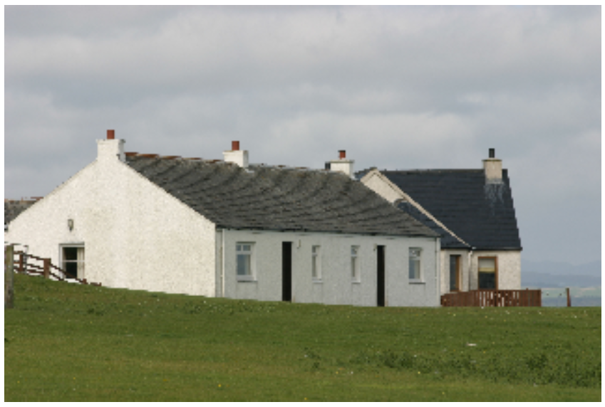
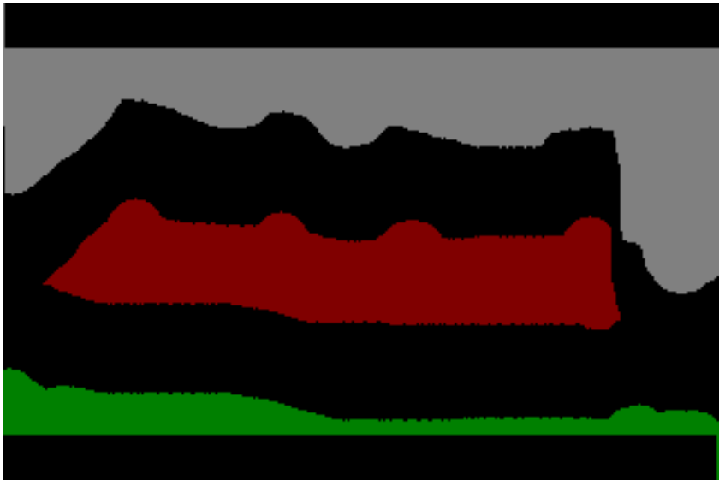
Learning from weak supervision
Learning MRF models of image region labeling
Full supervision:
all pixels labeled in train images
Weak supervision:
A subset of the pixels labeled with a category
No pixel-level labeling, only image-wide keywords given
Building, Grass, Sky

Slide 7
Image Region Labeling
We model distribution of region labels P(Y)
Spatially coherency: neighboring image regions tend to have the same label
Sparseness: often only a few of all our categories appear in each image
We model the appearance of visual categories P(X|Y)
Color, texture, relative position in image
Inference problem: Given image X, predict region labels Y
use the models p(Y) and p(X|Y) to define p(Y|X)
Car, building, road
Flower, grass
Airplane, building,
sky, grass
Boat, water, sky, tree, building
Car, building, sky tree, road

Slide 8
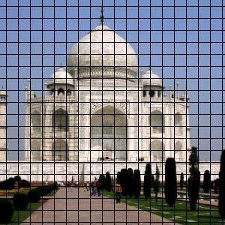
Modeling spatial coherency
Markov Random Fields for image region labeling
Divide image in rectangular regions (~1000 per image)
Each region variable y_{i} can take value 1, …, C for categories
MRF defines probability distribution over region labels
Variables independent of others given the neighboring variables
4 or 8 neighborhood system over regions
Potts model common choice for pair-wise interactions:

Slide 9
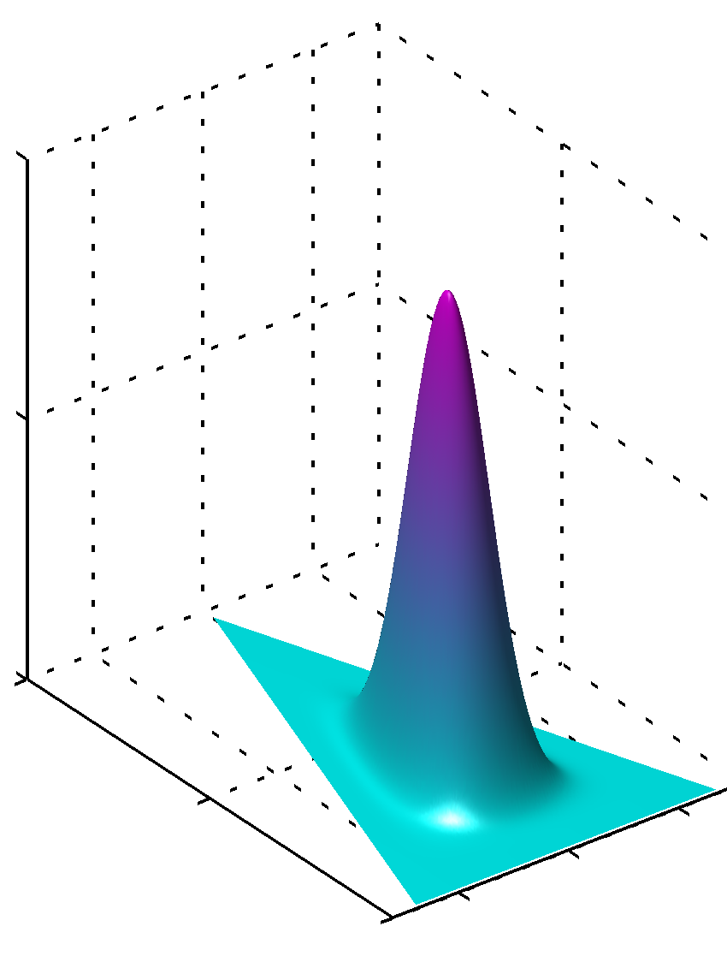
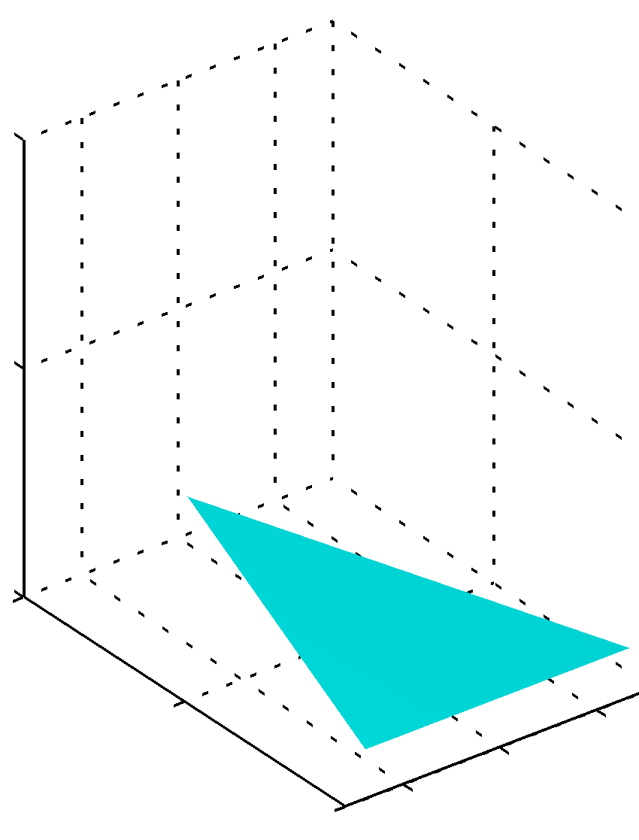
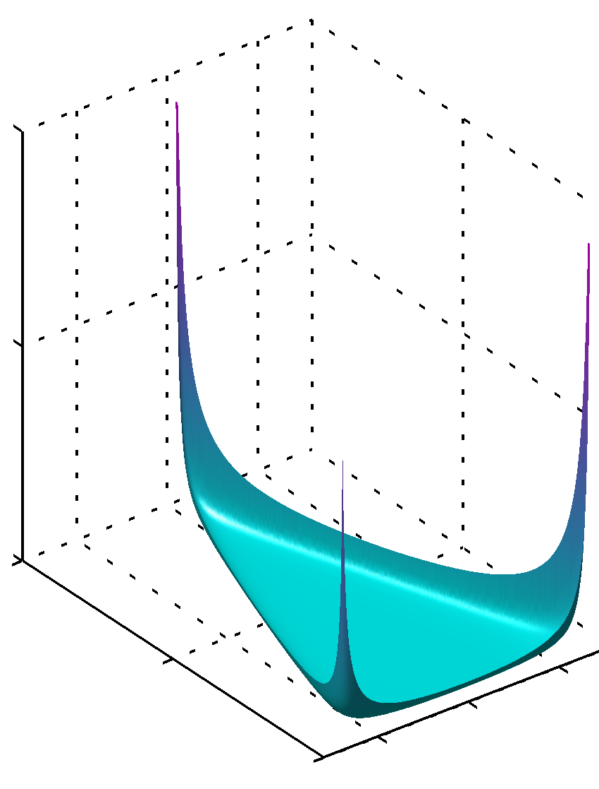
Latent Dirichlet Allocation
Model from text analysis literature
Text document is a mixture of several “topics” (categories)
Each topic is modeled as a multinomial over words in dictionary
Sparse Dirichlet distribution p(θ;α) over topic distribution

Slide 10
Markov Field Aspect Model
Define prior over region labels as product of LDA and MRF
MRF: local interactions for spatial contiguity
LDA: global interactions to enforce sparseness
Observation model encodes appearance of visual categories
Appearance modeled with color, texture, and position features

Slide 11
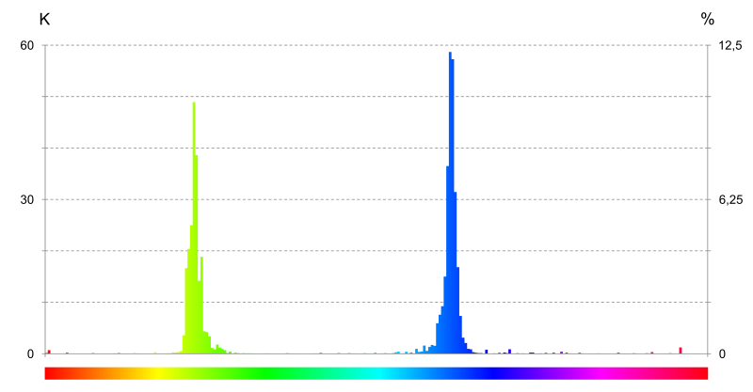
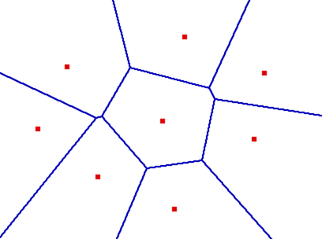
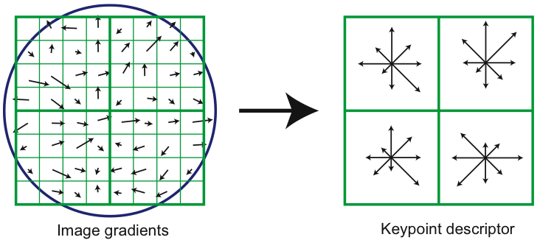
Appearance Models
Region position quantized into 10 x 10 cells
Multinomial distribution over cells per category
Color captured by histogram of hue values in region
Compute 32 bin histogram over region
Histograms quantized using k-means
Histogram represented by index of nearest center
Multinomial distribution over indexes per category
Region texture captured by SIFT descriptor
Region divided into cells
Histogram of gradient orientations in cell
K-means quantization
1
2
3
5
7
4
8
6

Slide 12
Markov Field Aspect Model
Inference: assign image regions to categories
p(Y|X) intractable to represent: exponential nr of states
p(y_{i}|X) tractable to represent, intractable to compute
Use Gibbs sampler to estimate posterior distribution
Iteratively sample each region label given other sampled values
Eventually generates samples from posterior distribution p(Y|X)
Gibbs samplers for product of models,
given by the product of Gibbs samplers of individual models
Appearance
Neighboring
region labels
Image-wide
region label stats

Slide 13
Learning category appearance
Training images labeled at image level, region labels unknown
Maximize likelihood of region appearances in training images
Iterative optimization using constrained EM algorithm
E-step: infer region labels using current parameters
Gibbs sampler, constrained by image-wide annotation keywords
M-step: fit appearance model of each class to weighted regions

Slide 14
Markov Field Aspect Model Example
Appearance models assumed known
Inference using LDA
Inference using our Markov Field Aspect model

Slide 15
Performance evaluation
Data set: 291 images from Microsoft Research Cambridge
Categories: aeroplane, bicycle, building, car, cow, face, grass, sky, tree
Performance measure: fraction of pixels correctly identified
Measured per category, then averaged over all categories
 | LDA | MRF | MRF & LDA
Pixels labels | 78.5 % | - | 82.3 %
Image labels | 74.0 % | 74.5 % | 80.2 %

Slide 16
Summary & outlook
Learning image region labeling from weak supervision
Combined MRF + LDA model improves recognition
Relatively good recognition when learning from keyword annotation
Also when learning from partially labeled images
Models expanded in more recent work
Extensions for future work
Co-occurrence of object categories in images
Dependence of appearance given region labels (higher order observations)
More directions in learning from weak supervision
Learning image annotation models from noisy user tags (eg Flickr)
Retrieval of actions and actors in video: scripts and audio

Slide 17
Performance evaluation
Extended data set with 22 categories

Slide 18
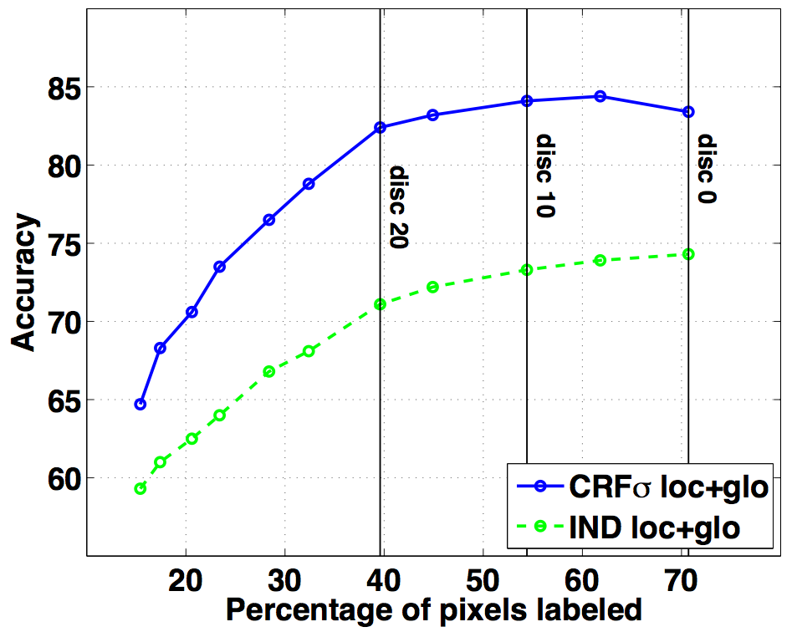
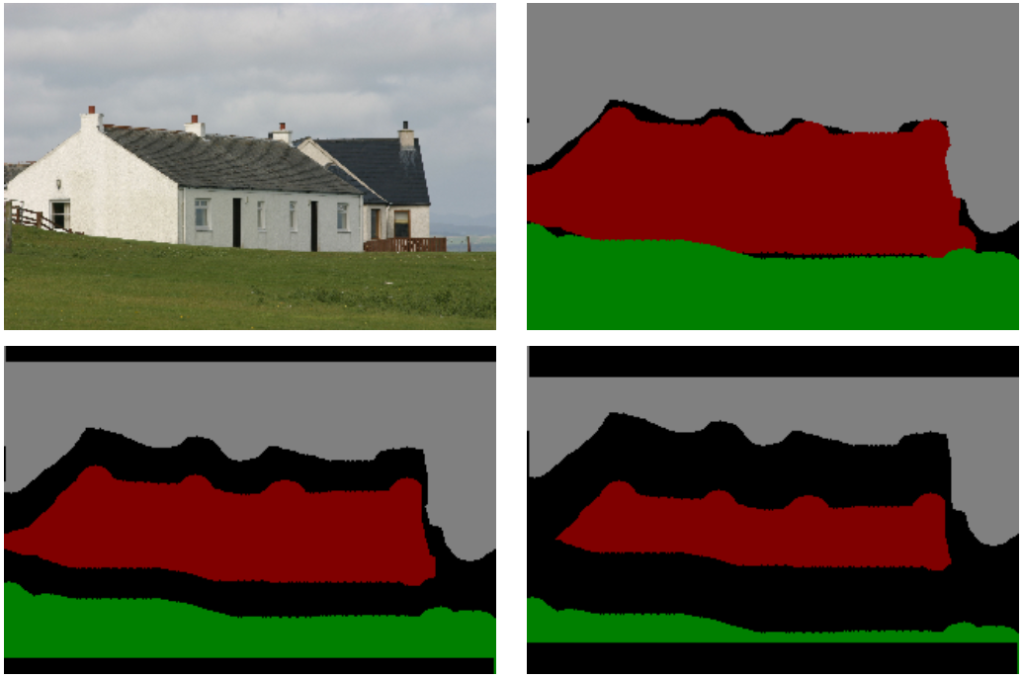
Learning from partial image labeling
How does recognition depend on the detail of training labels
Training labels progressively removed around category boundaries
Train recognition model from partially labeled images
Classify pixels in other images to assess performance
[Verbeek & Triggs, NIPS 2008]

Slide 19
Learning from partial image labeling
Fully supervised learning: maximum likelihood criterion
Generative model: likelihood of region appearance & labels: P(X,Y)
Conditional model: likelihood of region labels given appearance: P(Y|X)
Weakly supervised learning: maximum likelihood criterion
Marginalize over all valid completions of the partial labeling
Generative , or conditional
Difficulty: summing over an exponential number of label completions

