Slide 1
The Problem with the Blank Slate Approach
Derek Hoiem
Beckman Institute, UIUC
* unpublished *

Slide 2
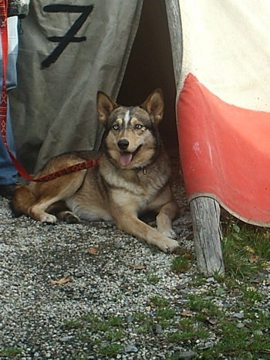
Scene Understanding: What We Have
7
TENT
DOG
GROUND

Slide 3
Scene Understanding: What We Have (More Realistically)
7
CAR
GROUND

Slide 4
Scene Understanding: What We Want
What/where: Large, furry dog lying in opening of tent, leashed to tent
Why: The tent provides shelter from the bright sun.
What if: What would happen if I tried to pet the dog?

Slide 5
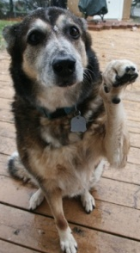
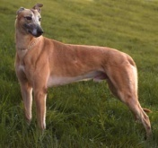
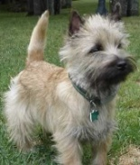
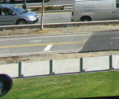

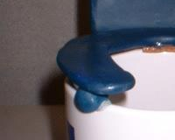
The Blank Slate Approach to Recognition
LAB Histogram
x
x
x
x
x
Textons
o
x
o
x
o
o
HOG
o
x
Bag of SIFT
x
_____
Examples
+
+
Image Features
Classifier
= Object Definition
The Assumption: It is possible to learn to recognize an object from positive and negative examples (with the right features, classifier, etc)

Slide 6
Problems with the Blank Slate Approach
Is inefficient

Slide 7
Inefficient: Objects Defined in Isolation
Person
+/- Person Examples
Feature Space
Classifier
= Patch → “Person”?
Building
+/- Building Examples
Feature Space
Classifier
= Patch → “Building”?
Road
+/- Road Examples
Feature Space
Classifier
= Patch → “Road”?
Car
+/- Car Examples
Feature Space
Classifier
= Patch → “Car”?
Dog
+/- Dog Examples
Feature Space
Classifier
= Patch → “Dog”?

Slide 8
Problems with the Blank Slate Approach
Is inefficient.
Does not allow the underlying concept to be learned.

Slide 9
A View from Semiotics (study of signs)
Signifiers
Signified (Mental Concept)
recognition
squirrel-chaser
barks
pet
furry
reproduces
translation
four-legged
face-licker
dog
Saussure 1916

Slide 10
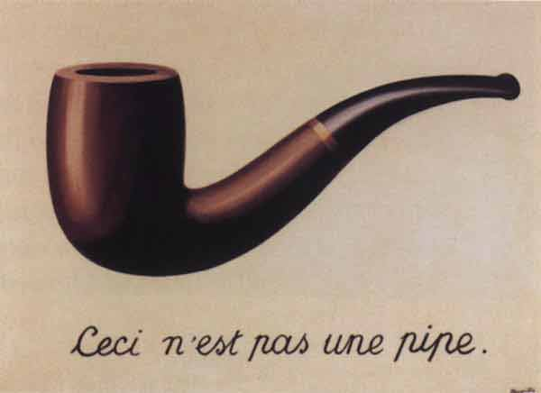

Magritte’s Warning
pipe
Ceci aussi n’est pas une pipe .
The Treachery of Images –Magritte 1929

Slide 11
Problems with the Blank Slate Approach
Is inefficient.
Does not allow the underlying concept to be learned.
Might not allow accurate naming.

Slide 12
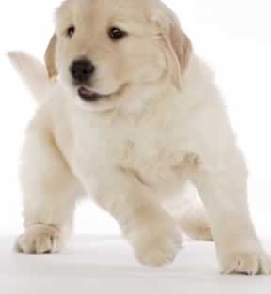
A Flawed Argument for Blank Slate Approach
People can identify objects in isolation
But inference ≠ learning - it might not be possible to learn to identify objects from +/- examples
Notes:
Encryption example

Slide 13
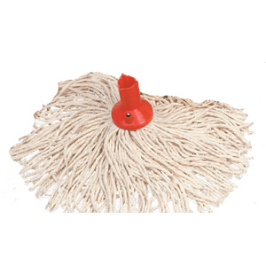
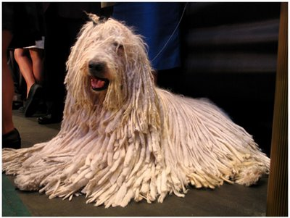
Appearances are Just Symptoms

Slide 14
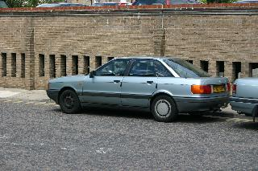
Quantitative and Qualitative Gap
Quantitative
  CalTech 101: ~85% accuracy
  CalTech 256: ~65% accuracy
  MSRC 21: ~75% accuracy
  PASCAL 2007: 0.1 – 0.45 average precision
Qualitative

Slide 15
Moving Beyond the Blank Slate

Slide 16
Major Shifts in Approach
Progressive vision: from starting from scratch to accumulating knowledge

Slide 17
Major Shifts in Approach
Progressive vision: from starting from scratch to accumulating knowledge
From isolated to relational models of objects
OLD
NEW
“dog” =
“dog” =
LAB Histogram
x
x
squirrel-chaser
x
x
barks
x
1-4 ft high
furry
Textons
+
o
has tail
x
o
x
o
o
four-legged
pet
HOG
o
x
face-licker
Bag of SIFT
x

Slide 18
Major Shifts in Approach
Progressive vision: from starting from scratch to accumulating knowledge
From isolated to relational models of objects
Beyond naming: infer properties and explain cause and predict effect
What/where: Large, furry dog lying in opening of tent, leashed to tent
Why: The tent provides shelter from the bright sun.
What if: What would happen if I tried to pet the dog?

Slide 19
Existing Solutions are not Enough
More data
  May never have enough
  No understanding
Feature sharing or “deep learning”
  May not be possible to discover underlying concepts from visual data
  “Hidden” features cannot be communicated (or independently improved)
  Still no understanding
Compositional models
  Only handles “part of” relation
Context with graphical models
  Hand-designed relational structure: brittle, not scalable

Slide 20
Key Step: Incorporate Background Knowledge
Describe in Terms of Background Knowledge
Bias Feature Relevance
Things
LAB Histogram
x
x
x
x
x
Attributes
Textons
o
x
o
x
o
o
HOG
o
Relations
x
Bag of SIFT
x
Background
Examples
+
+
Image Features
Classifier

Slide 21
Uses of Background Knowledge
Background knowledge (things that can be identified and relational structures) can
Serves as building blocks for new concepts
Helps determine what is likely to be important
Allows properties to be inferred through class hierarchies
Early Category and Concept Development – Eds. Rakison and Oakes 2003
Notes:
Concepts with short descriptions are easier to learn
Crucial appearance cues may be subtle

Slide 22
Uses of Background Knowledge: Examples
Using background knowledge as building blocks
Explaining away large “stuff”

Slide 23
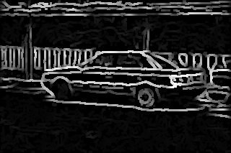
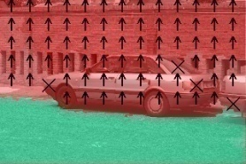
Background Knowledge as Building Blocks
Independently Trained Appearance Models
Set of Possible Relations
Object Appearance Model
Boundary Appearance Model
…
Surface Appearance Model
Near
Looks like
…
Part of
Input Image
…
Object Concept Model
Final Object Estimates
+/- Training Examples

Slide 24
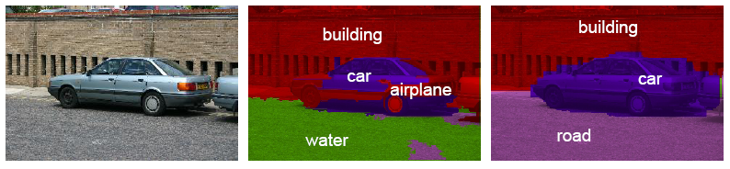
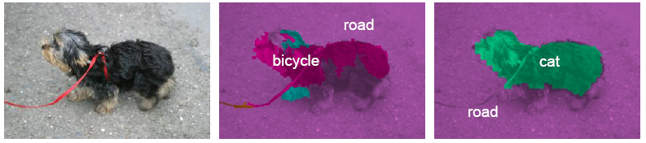
Results on MSRC 21
Method | Average Pixel Accuracy
Multisegs (baseline) | 72%
Final Result (with knowledge) | 80%
Best Published | ~75%
Input Image
Appearance Only
Conceptual Model

Slide 25
Most image area belongs to a few categories
Percent of Fully Labeled Image Area
Plot here

Slide 26
Many of these can be recognized with high precision
Precision Recall for 60 Classes (total area = 0.95)
Plot here

Slide 27
Being able to recognize the big stuff is useful
Recognize big stuff and ignore it
  Efficient search strategies
  Improve object discovery
Big stuff provides context

Slide 28
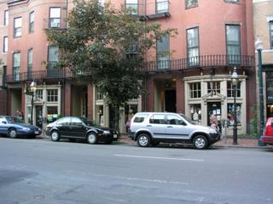
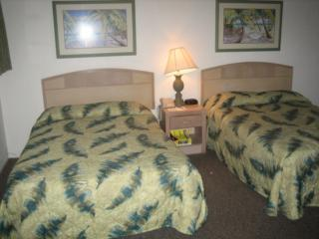

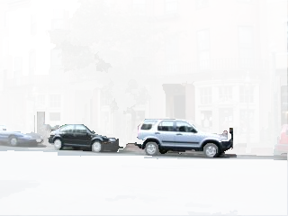
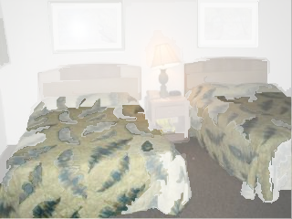
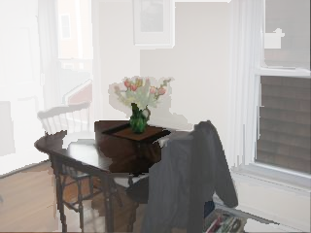
Explaining Away the Big Stuff
Images
Alpha mask = 1 - P(background)

Slide 29
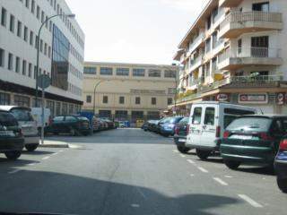
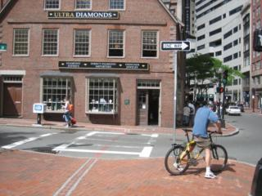
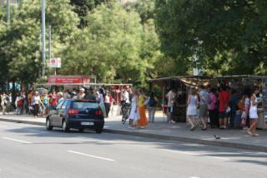
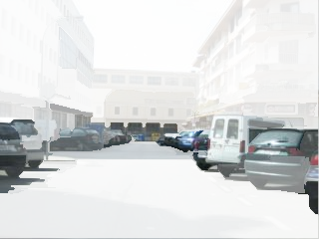
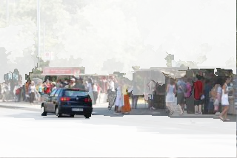
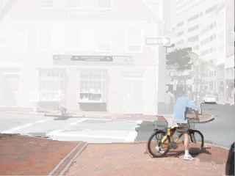
Explaining Away the Big Stuff
Images
Alpha mask = 1 - P(background)

Slide 30
Knowledge-Based Regularization
Add penalties for assigning weights to features or relations that are unlikely to be relevant, inferred by
  Superclasses (soft inheritance)
  Guidance from semantic webs, text mining, or instruction
  Similar objects
  Functional attributes

Slide 31
Conclusions
The blank slate approach is not sufficient for scene understanding
We need an approach that progressively builds on existing knowledge
  Broader recognition (beyond nouns and verbs)
  New representations to support relational models
  New mechanisms for relational learning and knowledge transfer
  New types of evaluation
  Integration with linguists, psychologists, etc.
Notes:
The blank slate approach is not sufficient for robust and efficient scene understanding
We need an approach that progressively builds on existing knowledge, making each new visual attribute or object easier to identify
Such an approach requires representations that support relational models and learning mechanisms that benefit from them, as well as broader interaction with other subareas of AI
Preliminary research efforts show these ideas to have high potential for large quantitative and qualitative improvements

