Slide 1
Discrete Inference and Learning
Lecture 2: Maximum Flow, Minimum Cut
Yuliya Tarabalka
yuliya.tarabalka@inria.fr
Slides courtesy of Pawan Kumar

Slide 2
Outline
Preliminaries
Functions and Excess Functions
s-t Flow
s-t Cut
Flows vs. Cuts
Maximum Flow
Algorithms
Energy minimization with max flow/min cut

Slide 3
Context
Example: network optimization problems

Slide 4
Maximum flow problem
Applications
Maximize the flow through a company’s distribution network from factories to customers
Maximize the flow of oil through a system of pipelines
Maximize the flow of vehicles through a transportation network

Slide 5
Functions on Arcs
s
D = (V, A)
1
1
10
8
Arc capacities c(a)
4
v₁
6
v₂
Function f: A ➔ Reals
3
3
2
Excess function E_{f}(v)
Incoming value
-
Outgoing value
v₃
v₄
5
7
3
3
t

Slide 6
Functions on Arcs
s
D = (V, A)
1
1
10
8
Arc capacities c(a)
4
v₁
6
v₂
Function f: A ➔ Reals
3
3
2
Excess function E_{f}(v)
Σ_{a∈in-arcs(v)} f(a)
-
Outgoing value
v₃
v₄
5
7
3
3
t

Slide 7
Functions on Arcs
s
D = (V, A)
1
1
10
8
Arc capacities c(a)
4
v₁
6
v₂
Function f: A ➔ Reals
3
3
2
Excess function E_{f}(v)
Σ_{a∈in-arcs(v)} f(a)
-
Σ_{a∈out-arcs(v)} f(a)
v₃
v₄
5
7
3
3
t

Slide 8
Functions on Arcs
s
D = (V, A)
1
1
10
8
Arc capacities c(a)
4
v₁
6
v₂
Function f: A ➔ Reals
3
3
2
Excess function E_{f}(v)
f(in-arcs(v))
-
f(out-arcs(v))
v₃
v₄
5
7
3
3
t
E_{f}(v₁)
-6

Slide 9
Functions on Arcs
s
D = (V, A)
1
1
10
8
Arc capacities c(a)
4
v₁
6
v₂
Function f: A ➔ Reals
3
3
2
Excess function E_{f}(v)
f(in-arcs(v))
-
f(out-arcs(v))
v₃
v₄
5
7
3
3
t
E_{f}(v₂)
14

Slide 10
Excess Functions of Vertex Subsets
s
Excess function E_{f}(U)
1
1
10
8
Incoming Value
-
Outgoing Value
4
v₁
6
v₂
3
3
2
v₃
v₄
5
7
3
3
t

Slide 11
Excess Functions of Vertex Subsets
s
Excess function E_{f}(U)
1
1
10
8
Σ_{a∈in-arcs(U)} f(a)
-
Outgoing Value
4
v₁
6
v₂
3
3
2
v₃
v₄
5
7
3
3
t

Slide 12
Excess Functions of Vertex Subsets
s
Excess function E_{f}(U)
1
1
10
8
Σ_{a∈in-arcs(U)} f(a)
-
Σ_{a∈out-arcs(U)} f(a)
4
v₁
6
v₂
3
3
2
v₃
v₄
5
7
3
3
t

Slide 13
Excess Functions of Vertex Subsets
s
Excess function E_{f}(U)
1
1
10
8
f(in-arcs(U))
-
f(out-arcs(U))
4
v₁
6
v₂
3
3
2
E_{f}({v₁,v₂})
8
v₃
v₄
5
7
3
3
t

Slide 14
Excess Functions of Vertex Subsets
s
Excess function E_{f}(U)
1
1
10
8
f(in-arcs(U))
-
f(out-arcs(U))
4
v₁
6
v₂
3
3
2
E_{f}({v₁,v₂})
-6 + 14
v₃
v₄
5
E_{f}(U) = Σ_{v∈U} E_{f}(v)
7
3
3
t

Slide 15
Outline
Preliminaries
Functions and Excess Functions
s-t Flow
s-t Cut
Flows vs. Cuts
Maximum Flow
Algorithms
Energy minimization with max flow/min cut

Slide 16
s-t Flow
s
Function flow: A ➔ R
1
8
Flow of arc ≤ arc capacity
v₁
6
v₂
Flow is non-negative
3
2
For all vertex except s,t
v₃
v₄
Incoming flow
5
= Outgoing flow
7
3
t

Slide 17
s-t Flow
s
Function flow: A ➔ R
1
8
flow(a) ≤ c(a)
v₁
6
v₂
Flow is non-negative
3
2
For all vertex except s,t
v₃
v₄
Incoming flow
5
= Outgoing flow
7
3
t

Slide 18
s-t Flow
s
Function flow: A ➔ R
1
8
flow(a) ≤ c(a)
v₁
6
v₂
flow(a) ≥ 0
3
2
For all vertex except s,t
v₃
v₄
Incoming flow
5
= Outgoing flow
7
3
t

Slide 19
s-t Flow
s
Function flow: A ➔ R
1
8
flow(a) ≤ c(a)
v₁
6
v₂
flow(a) ≥ 0
3
2
For all v ∈ V \ {s,t}
v₃
v₄
Incoming flow
5
= Outgoing flow
7
3
t

Slide 20
s-t Flow
s
Function flow: A ➔ R
1
8
flow(a) ≤ c(a)
v₁
6
v₂
flow(a) ≥ 0
3
2
For all v ∈ V \ {s,t}
v₃
v₄
Σ_{(u,v)∈A} flow((u,v))
5
= Outgoing flow
7
3
t

Slide 21
s-t Flow
s
Function flow: A ➔ R
1
8
flow(a) ≤ c(a)
v₁
6
v₂
flow(a) ≥ 0
3
2
For all v ∈ V \ {s,t}
v₃
v₄
Σ_{(u,v)∈A} flow((u,v))
5
= Σ_{(v,u)∈A} flow((v,u))
7
3
t

Slide 22
s-t Flow
s
Function flow: A ➔ R
1
8
flow(a) ≤ c(a)
v₁
6
v₂
flow(a) ≥ 0
3
2
For all v ∈ V \ {s,t}
v₃
v₄
E_{flow}(v) = 0
5
7
3
t

Slide 23
s-t Flow
s
Function flow: A ➔ R
1
1
10
8
4
flow(a) ≤ c(a)
v₁
6
v₂
flow(a) ≥ 0
3
3
2
For all v ∈ V \ {s,t}
v₃
v₄
E_{flow}(v) = 0
5
7
3
3
t
✗

Slide 24
s-t Flow
s
Function flow: A ➔ R
-1
1
8
flow(a) ≤ c(a)
v₁
6
v₂
flow(a) ≥ 0
-1
3
2
For all v ∈ V \ {s,t}
v₃
v₄
E_{flow}(v) = 0
5
7
-1
3
t
✗

Slide 25
s-t Flow
s
Function flow: A ➔ R
1
1
8
flow(a) ≤ c(a)
v₁
6
v₂
flow(a) ≥ 0
1
3
2
For all v ∈ V \ {s,t}
v₃
v₄
E_{flow}(v) = 0
5
7
1
3
t
✓

Slide 26
Value of s-t Flow
s
1
8
v₁
6
v₂
Outgoing flow of s
3
2
- Incoming flow of s
v₃
v₄
5
7
3
t

Slide 27
Value of s-t Flow
s
1
8
-E_{flow}(s)
E_{flow}(t)
v₁
6
v₂
Σ_{(s,v)∈A} flow((s,v))
3
2
- Σ_{(u,s)∈A} flow((u,s))
v₃
v₄
5
7
3
t

Slide 28
Value of s-t Flow
s
1
1
8
-E_{flow}(s)
E_{flow}(t)
v₁
6
v₂
Σ_{(s,v)∈A} flow((s,v))
1
3
2
- Σ_{(u,s)∈A} flow((u,s))
v₃
v₄
Value = 1
5
7
1
3
t

Slide 29
Outline
Preliminaries
Functions and Excess Functions
s-t Flow
s-t Cut
Flows vs. Cuts
Maximum Flow
Algorithms
Energy minimization with max flow/min cut

Slide 30
Cut
D = (V, A)
Let U be a subset of V
v₁
10
v₂
3
2
C is a set of arcs such that
(u,v) ∈ A
u ∈ U
v ∈ V\U
v₃
v₄
5
C is a cut in the digraph D

Slide 31
Cut
D = (V, A)
U
What is C?
v₁
10
v₂
{(v₁,v₂),(v₁,v₄)} ?
3
2
{(v₁,v₄),(v₃,v₂)} ?
v₃
v₄
✓
{(v₁,v₄)} ?
5
V\U

Slide 32
Cut
D = (V, A)
V\U
U
What is C?
v₁
10
v₂
{(v₁,v₂),(v₁,v₄),(v₃,v₂)} ?
3
2
✓
{(v₄,v₃)} ?
v₃
v₄
{(v₁,v₄),(v₃,v₂)} ?
5

Slide 33
Cut
D = (V, A)
U
V\U
What is C?
v₁
10
v₂
✓
{(v₁,v₂),(v₁,v₄),(v₃,v₂)} ?
3
2
{(v₃,v₂)} ?
v₃
v₄
{(v₁,v₄),(v₃,v₂)} ?
5

Slide 34
Cut
D = (V, A)
v₁
10
v₂
3
2
C = out-arcs(U)
v₃
v₄
5

Slide 35
Capacity of Cut
v₁
10
v₂
3
2
Sum of capacity of all
arcs in C
v₃
v₄
5

Slide 36
Capacity of Cut
v₁
10
v₂
3
2
Σ_{a ∈ C} c(a)
v₃
v₄
5

Slide 37
Capacity of Cut
U
v₁
10
v₂
3
3
2
v₃
v₄
5
V\U

Slide 38
Capacity of Cut
U
V\U
v₁
10
v₂
15
3
2
v₃
v₄
5

Slide 39
s-t Cut
s
D = (V, A)
1
8
A source vertex “s”
v₁
6
v₂
A sink vertex “t”
3
2
C is a cut such that
s ∈ U
t ∈ V\U
v₃
v₄
5
7
3
t
C is an s-t cut

Slide 40
Capacity of s-t Cut
s
1
8
v₁
6
v₂
Σ_{a ∈ C} c(a)
3
2
v₃
v₄
5
7
3
t

Slide 41
Capacity of s-t Cut
s
1
8
v₁
6
v₂
5
3
2
v₃
v₄
5
7
3
t

Slide 42
Capacity of s-t Cut
s
1
8
v₁
6
v₂
17
3
2
v₃
v₄
5
7
3
t

Slide 43
Outline
Preliminaries
Functions and Excess Functions
s-t Flow
s-t Cut
Flows vs. Cuts
Maximum Flow
Algorithms
Energy minimization with max flow/min cut

Slide 44
Flows vs. Cuts
An s-t flow function : A ➔ Reals
An s-t cut C such that s ∈ U, t ∈ V\U
Value of flow ≤ Capacity of C

Slide 45
Flows vs. Cuts
Value of flow
= -E_{flow}(s)
= -E_{flow}(s) - Σ_{v∈U\{s}} E_{flow}(v)
= -E_{flow}(U)
= flow(out-arcs(U))
- flow(in-arcs(U))
≤ Capacity of C
- flow(in-arcs(U))

Slide 46
Flows vs. Cuts
Value of flow
= -E_{flow}(s)
= -E_{flow}(s) - Σ_{v∈U\{s}} E_{flow}(v)
= -E_{flow}(U)
= flow(out-arcs(U))
- flow(in-arcs(U))
≤ Capacity of C
When does equality hold?

Slide 47
Flows vs. Cuts
Value of flow
= -E_{flow}(s)
= -E_{flow}(s) - Σ_{v∈U\{s}} E_{flow}(v)
= -E_{flow}(U)
= flow(out-arcs(U))
- flow(in-arcs(U))
≤ Capacity of C
flow(a) = c(a), a ∈ out-arcs(U)
flow(a) = 0, a ∈ in-arcs(U)

Slide 48
Flows vs. Cuts
Value of flow
= -E_{flow}(s)
= -E_{flow}(s) - Σ_{v∈U\{s}} E_{flow}(v)
= -E_{flow}(U)
= flow(out-arcs(U))
- flow(in-arcs(U))
= Capacity of C
flow(a) = c(a), a ∈ out-arcs(U)
flow(a) = 0, a ∈ in-arcs(U)

Slide 49
Outline
Preliminaries
Maximum Flow
Residual Graph
Max-Flow Min-Cut Theorem
Algorithms
Energy minimization with max flow/min cut

Slide 50
Maximum Flow Problem
s
Find the flow with the
maximum value !!
2
4
v₁
3
v₂
Σ_{(s,v)∈A} flow((s,v))
1
2
t
- Σ_{(u,s)∈A} flow((u,s))
First suggestion to solve this problem !!

Slide 51
Passing Flow through s-t Paths
s
Find an s-t path where
flow(a) < c(a) for all arcs
2
4
v₁
3
v₂
1
2
t

Slide 52
Passing Flow through s-t Paths
s
Find an s-t path where
flow(a) < c(a) for all arcs
1
2
4
v₁
3
v₂
Pass maximum allowable
flow through the arcs
1
1
2
t

Slide 53
Passing Flow through s-t Paths
s
Find an s-t path where
flow(a) < c(a) for all arcs
1
2
4
v₁
3
v₂
1
1
2
t

Slide 54
Passing Flow through s-t Paths
s
Find an s-t path where
flow(a) < c(a) for all arcs
1
2
4
2
v₁
3
v₂
Pass maximum allowable
flow through the arcs
1
1
2
2
t

Slide 55
Passing Flow through s-t Paths
s
Find an s-t path where
flow(a) < c(a) for all arcs
1
2
4
2
v₁
3
v₂
No more paths.
Stop.
1
1
2
2
t
Will this give us maximum flow?
NO !!!

Slide 56
Passing Flow through s-t Paths
s
Find an s-t path where
flow(a) < c(a) for all arcs
2
2
4
2
v₁
3
v₂
Pass maximum allowable
flow through the arcs
1
2
2
t

Slide 57
Passing Flow through s-t Paths
s
Find an s-t path where
flow(a) < c(a) for all arcs
2
2
4
2
v₁
3
v₂
No more paths.
Stop.
1
2
2
t
Another method?
Incorrect Answer !!

Slide 58
Outline
Preliminaries
Maximum Flow
Residual Graph
Max-Flow Min-Cut Theorem
Algorithms
Energy minimization with max flow/min cut

Slide 59
Residual Graph
s
s
2
2
4
2
v₁
3
v₂
v₁
v₂
1
2
2
t
t
Arcs where flow(a) < c(a)

Slide 60
Residual Graph
s
s
2
2
4
2
v₁
3
v₂
v₁
v₂
1
2
2
t
t
Including arcs to s and from t is not necessary
Inverse of arcs where flow(a) > 0

Slide 61
Maximum Flow using Residual Graphs
s
s
2
4
v₁
3
v₂
v₁
v₂
1
2
t
t
Start with zero flow.

Slide 62
Maximum Flow using Residual Graphs
s
s
2
4
v₁
3
v₂
v₁
v₂
1
2
t
t
Find an s-t path in the residual graph.

Slide 63
Maximum Flow using Residual Graphs
s
s
2
4
v₁
3
v₂
v₁
v₂
1
2
t
t
Find an s-t path in the residual graph.

Slide 64
Maximum Flow using Residual Graphs
s
s
2
4
v₁
3
v₂
v₁
v₂
1
2
t
t
For inverse arcs in path, subtract flow K.

Slide 65
Maximum Flow using Residual Graphs
s
s
2
4
v₁
3
v₂
v₁
v₂
1
2
t
t
Choose maximum allowable value of K.
For forward arcs in path, add flow K.

Slide 66
Maximum Flow using Residual Graphs
s
s
2
2
4
2
v₁
3
v₂
v₁
v₂
1
2
2
t
t
Choose maximum allowable value of K.
For forward arcs in path, add flow K.

Slide 67
Maximum Flow using Residual Graphs
s
s
2
2
4
2
v₁
3
v₂
v₁
v₂
1
2
2
t
t
Update the residual graph.

Slide 68
Maximum Flow using Residual Graphs
s
s
2
2
4
2
v₁
3
v₂
v₁
v₂
1
2
2
t
t
Find an s-t path in the residual graph.

Slide 69
Maximum Flow using Residual Graphs
s
s
2
2
4
2
v₁
3
v₂
v₁
v₂
1
2
2
t
t
Find an s-t path in the residual graph.

Slide 70
Maximum Flow using Residual Graphs
s
s
2
2
4
2
v₁
3
v₂
v₁
v₂
1
2
2
t
t
Choose maximum allowable value of K.
Add K to (s,v₂) and (v₁,t). Subtract K from (v₁,v₂).

Slide 71
Maximum Flow using Residual Graphs
s
s
2
2
4
1
1
v₁
3
v₂
v₁
v₂
1
1
2
2
t
t
Choose maximum allowable value of K.
Add K to (s,v₂) and (v₁,t). Subtract K from (v₁,v₂).

Slide 72
Maximum Flow using Residual Graphs
s
s
2
2
4
1
1
v₁
3
v₂
v₁
v₂
1
1
2
2
t
t
Update the residual graph.

Slide 73
Maximum Flow using Residual Graphs
s
s
2
2
4
1
1
v₁
3
v₂
v₁
v₂
1
1
2
2
t
t
Find an s-t path in the residual graph.

Slide 74
Maximum Flow using Residual Graphs
s
s
2
2
4
1
1
v₁
3
v₂
v₁
v₂
1
1
2
2
t
t
No more s-t paths. Stop.

Slide 75
Maximum Flow using Residual Graphs
s
s
2
2
4
1
1
v₁
3
v₂
v₁
v₂
1
1
2
2
t
t
Correct Answer.

Slide 76
Maximum Flow using Residual Graphs
s
s
1
4
v₁
3
v₂
v₁
v₂
2
2
t
t
Start with zero flow

Slide 77
Maximum Flow using Residual Graphs
s
s
1
4
v₁
3
v₂
v₁
v₂
2
2
t
t
Find an s-t path in the residual graph.

Slide 78
Maximum Flow using Residual Graphs
s
s
1
4
v₁
3
v₂
v₁
v₂
2
2
t
t
Find an s-t path in the residual graph.

Slide 79
Maximum Flow using Residual Graphs
s
s
1
4
v₁
3
v₂
v₁
v₂
2
2
t
t
For inverse arcs in path, subtract flow K.

Slide 80
Maximum Flow using Residual Graphs
s
s
1
4
v₁
3
v₂
v₁
v₂
2
2
t
t
Choose maximum allowable value of K.
For forward arcs in path, add flow K.

Slide 81
Maximum Flow using Residual Graphs
s
s
1
1
4
1
v₁
3
v₂
v₁
v₂
2
2
1
t
t
Choose maximum allowable value of K.
For forward arcs in path, add flow K.

Slide 82
Maximum Flow using Residual Graphs
s
s
1
1
4
1
v₁
3
v₂
v₁
v₂
2
2
1
t
t
Update the residual graph.

Slide 83
Maximum Flow using Residual Graphs
s
s
1
1
4
1
v₁
3
v₂
v₁
v₂
2
2
1
t
t
Find an s-t path in the residual graph.

Slide 84
Maximum Flow using Residual Graphs
s
s
1
1
4
1
v₁
3
v₂
v₁
v₂
2
2
1
t
t
Find an s-t path in the residual graph.

Slide 85
Maximum Flow using Residual Graphs
s
s
1
1
4
1
v₁
3
v₂
v₁
v₂
2
2
1
t
t
Choose maximum allowable value of K.
Add K to (s,v₂) and (v₁,t). Subtract K from (v₁,v₂).

Slide 86
Maximum Flow using Residual Graphs
s
s
1
1
4
1
v₁
3
v₂
v₁
v₂
1
2
2
1
t
t
Choose maximum allowable value of K.
Add K to (s,v₂) and (v₁,t). Subtract K from (v₁,v₂).

Slide 87
Maximum Flow using Residual Graphs
s
s
1
1
4
1
v₁
3
v₂
v₁
v₂
1
2
2
1
t
t
Update the residual graph.

Slide 88
Maximum Flow using Residual Graphs
s
s
1
1
4
1
v₁
3
v₂
v₁
v₂
1
2
2
1
t
t
Find an s-t path in the residual graph.

Slide 89
Maximum Flow using Residual Graphs
s
s
1
1
4
1
v₁
3
v₂
v₁
v₂
1
2
2
1
t
t
Find an s-t path in the residual graph.

Slide 90
Maximum Flow using Residual Graphs
s
s
1
1
4
1
v₁
3
v₂
v₁
v₂
1
2
2
1
t
t
Choose maximum allowable value of K.
Add K to (s,v₂) and (v₂,t).

Slide 91
Maximum Flow using Residual Graphs
s
s
1
1
4
2
v₁
3
v₂
v₁
v₂
1
2
2
2
t
t
Choose maximum allowable value of K.
Add K to (s,v₂) and (v₂,t).

Slide 92
Maximum Flow using Residual Graphs
s
s
1
1
4
2
v₁
3
v₂
v₁
v₂
1
2
2
2
t
t
Update residual graph.

Slide 93
Maximum Flow using Residual Graphs
s
s
1
1
4
2
v₁
3
v₂
v₁
v₂
1
2
2
2
t
t
No more s-t paths. Stop.

Slide 94
Maximum Flow using Residual Graphs
s
s
1
1
4
2
v₁
3
v₂
v₁
v₂
1
2
2
2
t
t
How can I be sure this will always work?

Slide 95
Outline
Preliminaries
Maximum Flow
Residual Graph
Max-Flow Min-Cut Theorem
Algorithms
Energy minimization with max flow/min cut

Slide 96
Max-Flow Min-Cut
s
s
1
1
4
2
v₁
3
v₂
v₁
v₂
1
2
2
2
t
t
t is not in U.
Let the subset of vertices U be reachable from s.

Slide 97
Max-Flow Min-Cut
s
s
1
1
4
2
v₁
3
v₂
v₁
v₂
1
2
2
2
t
t
Or else a will be in the residual graph.
For all a ∈ out-arcs(U), flow(a) = c(a).

Slide 98
Max-Flow Min-Cut
s
s
1
1
4
2
v₁
3
v₂
v₁
v₂
1
2
2
2
t
t
Or else inverse of a will be in the residual graph.
For all a ∈ in-arcs(U), flow(a) = 0.

Slide 99
Max-Flow Min-Cut
s
s
1
1
4
2
v₁
3
v₂
v₁
v₂
1
2
2
2
t
t
For all a ∈ out-arcs(U), flow(a) = c(a).
For all a ∈ in-arcs(U), flow(a) = 0.

Slide 100
Flows vs. Cuts
Value of flow
= -E_{flow}(s)
= -E_{flow}(s) - Σ_{v∈U\{s}} E_{flow}(v)
= -E_{flow}(U)
= flow(out-arcs(U))
- flow(in-arcs(U))
= Capacity of C
flow(a) = c(a), a ∈ out-arcs(U)
flow(a) = 0, a ∈ in-arcs(U)

Slide 101
Max-Flow Min-Cut
s
s
1
1
4
2
v₁
3
v₂
v₁
v₂
1
2
2
2
t
t
Minimum Cut
Maximum Flow
Capacity(C) = Value(flow)

Slide 102
Outline
Preliminaries
Maximum Flow
Algorithms
Ford-Fulkerson Algorithm
Dinits Algorithm
Energy minimization with max flow/min cut

Slide 103
Ford-Fulkerson Algorithm
Start with flow = 0 for all arcs.
Find an s-t path in the residual graph.
Pass maximum allowable flow.
REPEAT
Subtract from inverse arcs.
Add to forward arcs.
Until s and t are disjoint in the residual graph.

Slide 104
Ford-Fulkerson Algorithm
s
s
10^{k}
10^{k}
v₁
1
v₂
v₁
v₂
10^{k}
10^{k}
t
t
Start with zero flow

Slide 105
Ford-Fulkerson Algorithm
s
s
10^{k}
10^{k}
v₁
1
v₂
v₁
v₂
10^{k}
10^{k}
t
t
Find an s-t path in the residual graph.

Slide 106
Ford-Fulkerson Algorithm
s
s
10^{k}
10^{k}
v₁
1
v₂
v₁
v₂
10^{k}
10^{k}
t
t
Find an s-t path in the residual graph.

Slide 107
Ford-Fulkerson Algorithm
s
s
10^{k}
10^{k}
v₁
1
v₂
v₁
v₂
10^{k}
10^{k}
t
t
Pass the maximum allowable flow.

Slide 108
Ford-Fulkerson Algorithm
s
s
1
10^{k}
10^{k}
1
v₁
1
v₂
v₁
v₂
10^{k}
10^{k}
t
1
t
Pass the maximum allowable flow.

Slide 109
Ford-Fulkerson Algorithm
s
s
1
10^{k}
10^{k}
1
v₁
1
v₂
v₁
v₂
10^{k}
10^{k}
t
1
t
Update the residual graph.

Slide 110
Ford-Fulkerson Algorithm
s
s
1
10^{k}
10^{k}
1
v₁
1
v₂
v₁
v₂
10^{k}
10^{k}
t
1
t
Find an s-t path in the residual graph.

Slide 111
Ford-Fulkerson Algorithm
s
s
1
10^{k}
10^{k}
1
v₁
1
v₂
v₁
v₂
10^{k}
10^{k}
t
1
t
Find an s-t path in the residual graph.

Slide 112
Ford-Fulkerson Algorithm
s
s
1
10^{k}
10^{k}
1
v₁
1
v₂
v₁
v₂
10^{k}
10^{k}
t
1
t
Complexity is exponential in k.

Slide 113
Ford-Fulkerson Algorithm
s
s
1
10^{k}
10^{k}
1
v₁
1
v₂
v₁
v₂
10^{k}
10^{k}
t
1
t
For examples, see Uri Zwick, 1993
Irrational arc lengths can lead to infinite iterations.

Slide 114
Ford-Fulkerson Algorithm
s
s
1
10^{k}
10^{k}
1
v₁
1
v₂
v₁
v₂
10^{k}
10^{k}
t
1
t
Choose wisely.
There are good paths and bad paths.

Slide 115
Outline
Preliminaries
Maximum Flow
Algorithms
Ford-Fulkerson Algorithm
Dinits Algorithm
Energy minimization with max flow/min cut

Slide 116
Dinits Algorithm
Start with flow = 0 for all arcs.
Find the minimum s-t path
in the residual graph.
Pass maximum allowable flow.
REPEAT
Subtract from inverse arcs.
Add to forward arcs.
Until s and t are disjoint in the residual graph.

Slide 117
Dinits Algorithm
s
s
10^{k}
10^{k}
v₁
1
v₂
v₁
v₂
10^{k}
10^{k}
t
t
Start with zero flow

Slide 118
Dinits Algorithm
s
s
10^{k}
10^{k}
v₁
1
v₂
v₁
v₂
10^{k}
10^{k}
t
t
Find the minimum s-t path in the residual graph.

Slide 119
Dinits Algorithm
s
s
10^{k}
10^{k}
v₁
1
v₂
v₁
v₂
10^{k}
10^{k}
t
t
Find the minimum s-t path in the residual graph.

Slide 120
Dinits Algorithm
s
s
10^{k}
10^{k}
v₁
1
v₂
v₁
v₂
10^{k}
10^{k}
t
t
Pass the maximum allowable flow.

Slide 121
Dinits Algorithm
s
s
10^{k}
10^{k}
10^{k}
v₁
1
v₂
v₁
v₂
10^{k}
10^{k}
10^{k}
t
t
Pass the maximum allowable flow.

Slide 122
Dinits Algorithm
s
s
10^{k}
10^{k}
10^{k}
v₁
1
v₂
v₁
v₂
10^{k}
10^{k}
10^{k}
t
t
Update the residual graph.

Slide 123
Dinits Algorithm
s
s
10^{k}
10^{k}
10^{k}
v₁
1
v₂
v₁
v₂
10^{k}
10^{k}
10^{k}
t
t
Find the minimum s-t path in the residual graph.

Slide 124
Dinits Algorithm
s
s
10^{k}
10^{k}
10^{k}
v₁
1
v₂
v₁
v₂
10^{k}
10^{k}
10^{k}
t
t
Find the minimum s-t path in the residual graph.

Slide 125
Dinits Algorithm
s
s
10^{k}
10^{k}
10^{k}
v₁
1
v₂
v₁
v₂
10^{k}
10^{k}
10^{k}
t
t
Pass the maximum allowable flow.

Slide 126
Dinits Algorithm
s
s
10^{k}
10^{k}
10^{k}
10^{k}
v₁
1
v₂
v₁
v₂
10^{k}
10^{k}
10^{k}
t
10^{k}
t
Pass the maximum allowable flow.

Slide 127
Dinits Algorithm
s
s
10^{k}
10^{k}
10^{k}
10^{k}
v₁
1
v₂
v₁
v₂
10^{k}
10^{k}
10^{k}
t
10^{k}
t
Update the residual graph.

Slide 128
Dinits Algorithm
s
s
10^{k}
10^{k}
10^{k}
10^{k}
v₁
1
v₂
v₁
v₂
10^{k}
10^{k}
10^{k}
t
10^{k}
t
No more s-t paths. Stop.

Slide 129
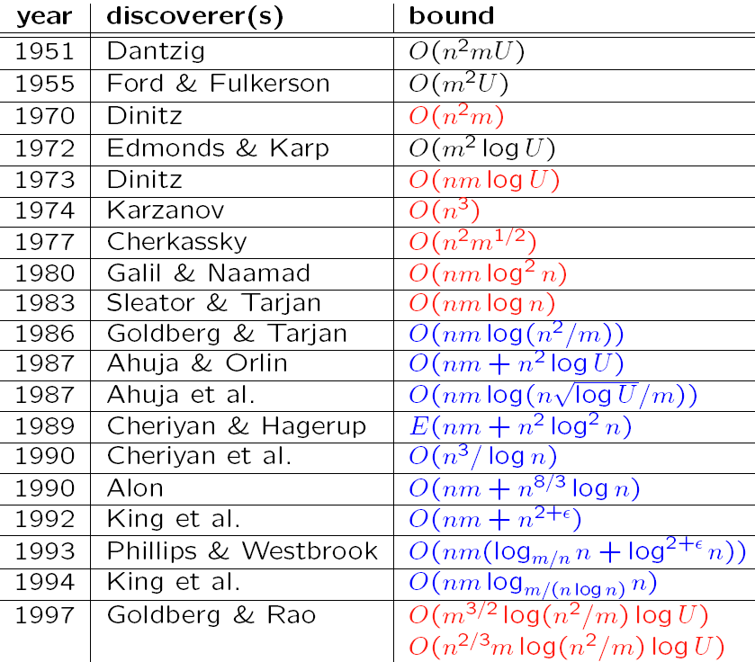
Solvers for the Minimum-Cut Problem
Augmenting Path and Push-Relabel
n: #nodes
m: #arcs
U: maximum
arc length
[Slide credit: Andrew Goldberg]

Slide 130
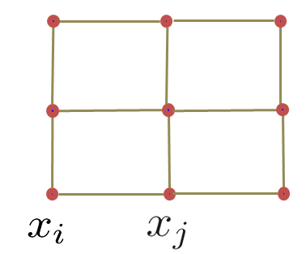
Max-Flow in Computer Vision
Specialized algorithms for vision problems
Grid graphs
Low connectivity (m ~ O(n))
Dual search tree augmenting path algorithm
[Boykov and Kolmogorov PAMI 2004]
Finds approximate shortest augmenting paths efficiently
High worst-case time complexity
Empirically outperforms other algorithms on vision problems
[Slide credit: Pushmeet Kohli]

Slide 131
Outline
Preliminaries
Maximum Flow
Algorithms
Energy minimization with max flow/min cut
Two-Label Energy Functions

Slide 132
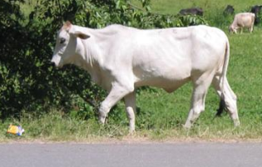
Interactive Binary Segmentation
Foreground histogram of RGB values FG
Background histogram of RGB values BG
‘1’ indicates foreground and ‘0’ indicates background

Slide 133
Interactive Binary Segmentation
More likely to be foreground than background

Slide 134
Interactive Binary Segmentation
θ_{p}(0) proportional to -log(BG(d_{a}))
θ_{p}(1) proportional to -log(FG(d_{a}))
More likely to be background than foreground

Slide 135
Interactive Binary Segmentation
More likely to belong to same label

Slide 136
Interactive Binary Segmentation
θ_{pq}(i,k) proportional to exp(-(d_{a}-d_{b})²) if i ≠ k
θ_{pq}(i,k) = 0 if i = k
Less likely to belong to same label

Slide 137
Overview
Energy E
One vertex per random variable
Digraph
D
+ Additional vertices “s” and “t”
Compute
Minimum
Cut
Labeling
x
v_{p} ∈ U implies x_{p} = 0
U and V\U
v_{p} ∈ V\U implies x_{p} = 1

Slide 138
Digraph for Unary Potentials
A
B
θ_{p}(1)
x_{p} = 0
θ_{p}(0)
x_{p} = 1
X_{p}

Slide 139
Digraph for Unary Potentials
A
B
s
x_{p} = 0
x_{p} = 1
v_{p}
t

Slide 140
Digraph for Unary Potentials
A
B
s
Let A ≥ B
x_{p} = 0
x_{p} = 1
v_{p}
Constant
A-B
A-B
0
B
B
t
+

Slide 141
Digraph for Unary Potentials
A
B
s
Let A ≥ B
x_{p} = 0
x_{p} = 1
x_{p} = 1
v_{p}
Constant
A-B
0
A-B
0
B
B
t
+

Slide 142
Digraph for Unary Potentials
A
B
s
Let A ≥ B
x_{p} = 0
x_{p} = 1
x_{p} = 0
v_{p}
Constant
A-B
A-B
A-B
0
B
B
t
+

Slide 143
Digraph for Unary Potentials
A
B
s
Let A < B
x_{p} = 0
B-A
x_{p} = 1
v_{p}
Constant
0
B-A
A
A
t
+

Slide 144
Digraph for Unary Potentials
A
B
s
Let A < B
x_{p} = 0
B-A
x_{p} = 1
x_{p} = 1
v_{p}
Constant
B-A
0
B-A
A
A
t
+

Slide 145
Digraph for Unary Potentials
A
B
s
Let A < B
x_{p} = 0
B-A
x_{p} = 1
x_{p} = 0
v_{p}
Constant
0
0
B-A
A
A
t
+

Slide 146
Digraph for Pairwise Potentials
x_{p} = 0
x_{p} = 1
θ_{pq}(1,1)
A | C
B | D
x_{q} = 0
θ_{pq}(0,1)
θ_{pq}(1,0)
x_{q} = 1
θ_{pq}(0,0)
X_{p}
X_{q}
A | A
A | A
0 | 0
B-A | B-A
0 | D-B
0 | D-B
0 | C+B-D-A
0 | 0
+
+
+

Slide 147
Digraph for Pairwise Potentials
x_{p} = 0
x_{p} = 1
A | C
B | D
x_{q} = 0
s
x_{q} = 1
Constant
v_{p}
v_{q}
A | A
A | A
t
0 | 0
B-A | B-A
0 | D-B
0 | D-B
0 | C+B-D-A
0 | 0
+
+
+

Slide 148
Digraph for Pairwise Potentials
x_{p} = 0
x_{p} = 1
A | C
B | D
x_{q} = 0
s
x_{q} = 1
B-A
v_{p}
v_{q}
Unary Potential
x_{q} = 1
t
0 | 0
B-A | B-A
0 | D-B
0 | D-B
0 | C+B-D-A
0 | 0
+
+

Slide 149
Digraph for Pairwise Potentials
x_{p} = 0
x_{p} = 1
A | C
B | D
x_{q} = 0
s
x_{q} = 1
D-B
B-A
v_{p}
v_{q}
t
Unary Potential
x_{p} = 1
0 | D-B
0 | D-B
0 | C+B-D-A
0 | 0
+

Slide 150
Digraph for Pairwise Potentials
x_{p} = 0
x_{p} = 1
A | C
B | D
x_{q} = 0
s
x_{q} = 1
D-B
B-A
v_{p}
C+B-D-A
v_{q}
t
Pairwise Potential
x_{p} = 1, x_{q} = 0
0 | C+B-D-A
0 | 0

Slide 151
Digraph for Pairwise Potentials
x_{p} = 0
x_{p} = 1
A | C
B | D
x_{q} = 0
s
x_{q} = 1
D-B
B-A
v_{p}
C+B-D-A
v_{q}
t
C+B-D-A ≥ 0
Submodular Energy
General 2-label MAP estimation is NP-hard

Slide 152
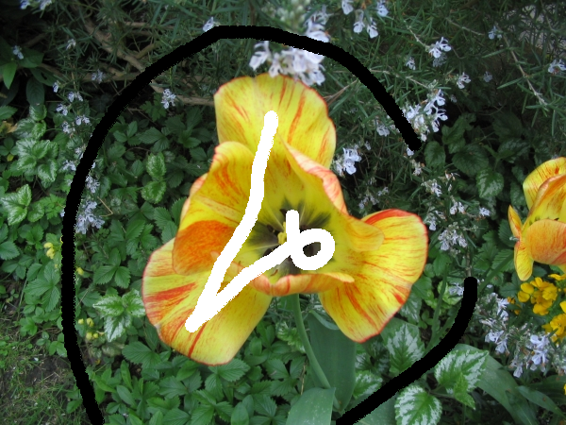
Results – Image Segmentation
Boykov and Jolly, ICCV 2001

Slide 153
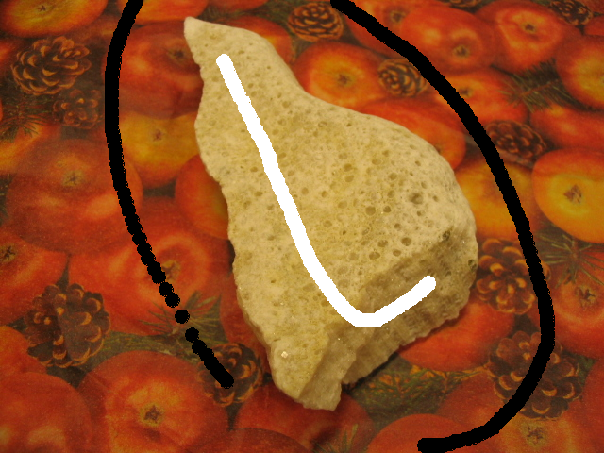
Results – Image Segmentation
Boykov and Jolly, ICCV 2001

Slide 154
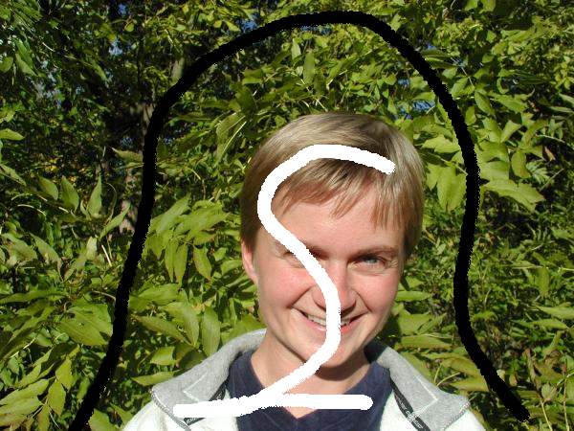
Results – Image Segmentation
Boykov and Jolly, ICCV 2001

Slide 155
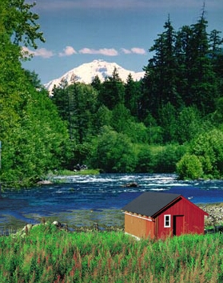
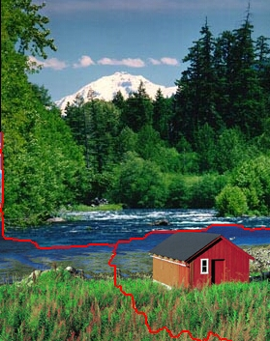
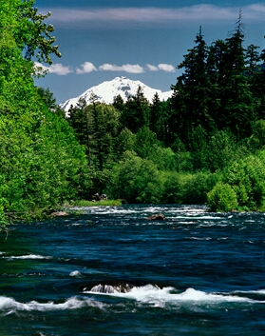
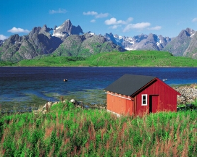
Results – Image Synthesis
Kwatra et al., SIGGRAPH 2003

Slide 156
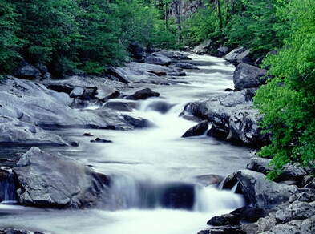
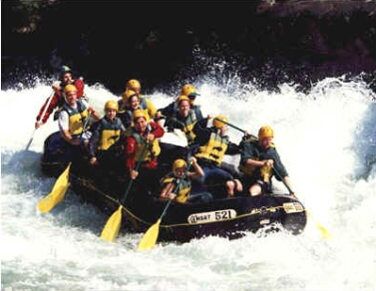
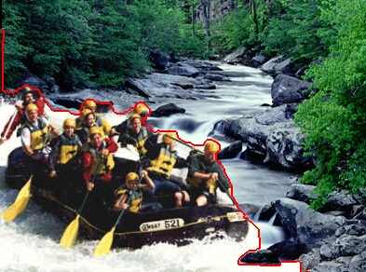
Results – Image Synthesis
Kwatra et al., SIGGRAPH 2003

Slide 157
Outline
Preliminaries
Maximum Flow
Algorithms
Energy minimization with max flow/min cut
Multi-Label Energy Functions

Slide 158
Move-Making Algorithms
Space of All Labelings
x

Slide 159
Expansion Algorithm
Variables take label l_{α} or retain current label
Slide courtesy Pushmeet Kohli

Slide 160
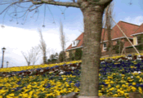
Expansion Algorithm
Variables take label l_{α} or retain current label
Tree
Ground
House
Status:
Initialize with Tree
Expand Ground
Expand House
Expand Sky
Sky
Slide courtesy Pushmeet Kohli

Slide 161
Expansion Algorithm
Initialize labeling x = x⁰ (say x⁰_{p} = 0, for all X_{p})
For α = 1, 2, … , h-1
x^{α} = argmin_{x’} E(x’)
s.t. x’_{p} ∈ {x_{p}} U {l_{α}}
Repeat
until
convergence
Update x = x^{α}
End
Boykov, Veksler and Zabih, 2001

Slide 162
Expansion Algorithm
Restriction on pairwise potentials?
θ_{pq}(i,k) + θ_{pq}(α,α) ≤ θ_{pq}(i,α) + θ_{pq}(α,k)

Slide 163
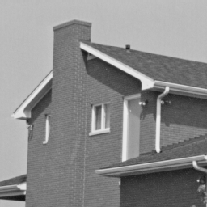
Results – Denoising + Inpainting
Notes:
Label = intensity value of the image

Slide 164
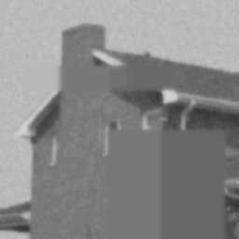
Results – Denoising + Inpainting

Slide 165
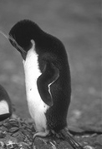
Results – Denoising + Inpainting

Slide 166
Results – Denoising + Inpainting

