Slide 1
Aggregating local image descriptors into compact codes
Authors:
Hervé Jegou
Florent Perroonnin
Matthijs Douze
Jorge Sánchez
Patrick Pérez
Cordelia Schmidt
Presented by:
Jiří Pytela
Ayan Basu Nath

Slide 2
Outline
Introduction
Method
Evaluation
From vectors to codes
Experiments
Conclusion

Slide 3
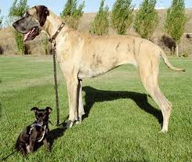
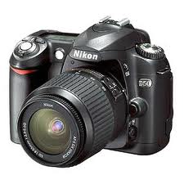
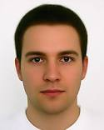
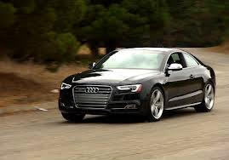
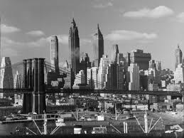
100M
Objective
Low memory usage
High efficiency
High accuracy

Slide 4
Existing methods
Bag-of-words
Aproximate NN search for BOW
Min-Hash
Pre-filtering
Low accuracy
High memory usage

Slide 5
Vector aggregation methods
Represent local descriptors by single vector
BOW
Fisher Vector
Vector of Locally Aggregated Descriptors (VLAD)

Slide 6
BOW
Requires codebook – set of „visual words“
> k-means clustering
Histogram

Slide 7
Fisher Vector
Extends BOW
„difference from an average distribution of descriptors“

Slide 8
Fisher Kernel
X – set of T descriptors
$u_{λ}$ - probability density function
λ - parameters
Fisher vector
Notes:
u is image independent
The gradient describes contribution of the parameters

Slide 9
Image representation
Gaussian Mixture Model
Parameters
mixture weight
mean vector
variance matrix
Probabilistic visual vocabulary

Slide 10
Image representation
Descriptor assignment
Vector representation
Power normalization
L2-normalization
Notes:
i is for visual keywords (components of the u)
L2-norm – |x| = sqrt(x1*x1 + x2*x2 ….)

Slide 11
FV – image specific data
real descriptor distribution

Slide 12
FV – image specific data
Estimation of parametres λ :
-> Image independent information is discarded
Notes:
This shows that the image-independent information is approximately
discarded from the FV signature
Image is on average described by what it makes different from other images

Slide 13
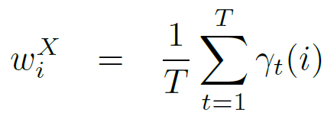
FV – final image representation
proportion of descriptors assigned to single visual word
average of the descriptors assigned to single visual word
Notes:
Wi - proportion of descriptors assigned to visual word i
Ui – average of the descriptors assigned to visual word i

Slide 14
FV – final image representation
Includes:
the number of descriptors assigned to visual word
approximate location of the descriptor
-> Frequent descriptors have lower value

Slide 15
Vector of Lacally Aggregated Descriptors (VLAD)
Non-probabilistic Fisher Kernel
Requires codebook (as BOW)
Associate each descriptor to its nearest neighbor
Compute the difference vector
Notes:
I is from 1 to K
Vi encodes the differences from target word
Ui is word from the codebook

Slide 16
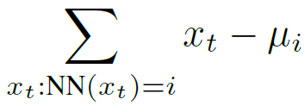
Comparison – VLAD and FV
Equal mixture weights
Isotropic covariance matrices
Notes:
I is from 1 to K
Vi encodes the differences from target word

Slide 17
VLAD descriptors
Dimensionality reduction
-> principal component analysis
Notes:
Descriptors are structured and similar for resembling images
Less energetic components are noisy
Decorrelated data better fit GMM

Slide 18
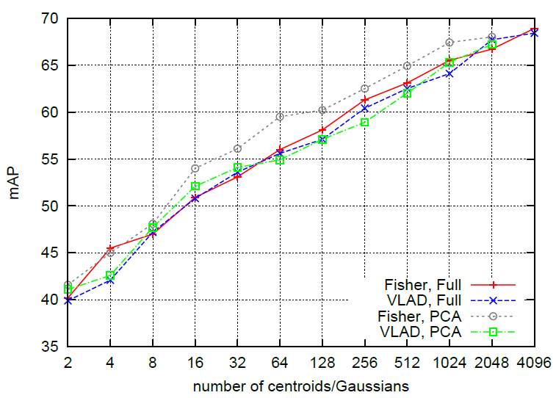
PCA comparison
Dimensionality reduction can increase accuracy
Notes:
Less energetic components are noisy
Decorrelated data better fit GMM

Slide 19
Evaluation
Compact representation -> D‘ = 128
High dimensional descriptions suffer from dimensionality reduction
FV and VLAD use only few visual words (K) !
Notes:
BOW – limited reduction is good
FV – better to use K = 64 than 256
D‘ – compressed descriptors

Slide 20
Evaluation
Each collection is combined with 10M or 100M image dataset
Copydays – near duplicate detection
Oxford – limited object variability
UKB – best preformance is 4
Notes:
GIST = low dimensional representation of the scene, which does not require any form of segmentation
D‘ – compressed descriptors
UKB – each object is represented by 4 imgs, shows the count of corresponding imgs in first 4 positions

Slide 21
FROM VECTORS TO CODES
Given a D-dimensional input vector
A code of B bits encoding the image representation
Handling problem in two steps:
a projection that reduces the dimensionality of the vector
a quantization used to index the resulting vectors

Slide 22
Approximate nearest neighbour
Required to handle large databases in computer vision applications
One of the most popular techniques is Euclidean Locality-Sensitive Hashing
Is memory consuming

Slide 23
The product quantization-based approximate search method
It offers better accuracy
The search algorithm provides an explicit approximation of the indexed vectors
compare the vector approximations introduced by the dimensionality reduction and the quantization
We use the asymmetric distance computation (ADC) variant of this approach

Slide 24
ADC approach
Let x ϵ R^{D} be a query vector
Y = {y1,…,Yn} a set of vectors in which we want to find the nearest neighbour NN(x) of x
consists in encoding each vector Y_{i} by a quantized version C_{i} = q(Y_{i}) ϵ R^{D}
For a quantizer q(.) with k centroids, the vector is encoded by B=log2(k) bits, k being a power of 2.
Finding the a nearest neighbours NNa(x) of x simply consists in computing

Slide 25
Indexation-aware dimensionality reduction
Dimensionality reduction
There exist a tradeoff between this operation and the indexing scheme
The D’ x D PCA matrix M maps descriptor x ϵ R^{D} to the transformed descriptor x’ = M x ϵ R^{D’}.
This dimensionality reduction can also be interpreted in the initial space as a projection. In that case, x is approximated by

Slide 26
Therefore the projection is x_{p} = M^{T}Mx
Observation:
Due to the PCA, the variance of the different components of x’ is not balanced.
There is a trade-off on the number of dimensions D’ to be retained by the PCA.
If D’ is large, the projection error vector ε_{p}(x) is of limited magnitude, but a large quantization error ε_{q}(x_{p}) is introduced.

Slide 27
Joint optimization of reduction/indexing
The squared Euclidean distance between the reproduction value and x is the sum of the errors and
The mean square error e(D’) is empirically measured on a learning vector set L as:

Slide 28
EXPERIMENTS
Evaluating the performance of the Fisher vector when used with the joint dimensionality reduction/indexing approach
Large scale experiments on Holidays+Flickr10M

Slide 29
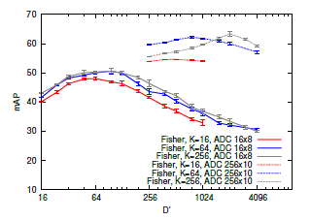
Dimensionality reduction and indexation

Slide 30
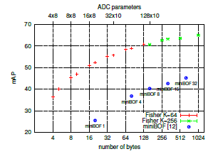
Comparison with the state of the art

Slide 31
The proposed approach is significantly more precise at all operating points
Compared to BOW, which gives mAP=54% for a 200k vocabulary, a competitive accuracy of mAP=55.2% is obtained with only 32 bytes.

Slide 33
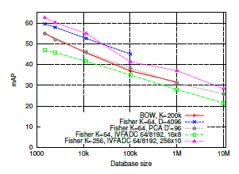
Large-scale experiments
Experiments on Holidays and Flickr10M

Slide 34
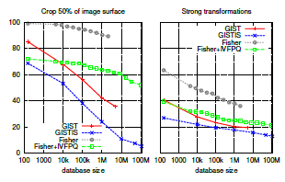
Experiments on Copydays and Exalead100M

Slide 35
CONCLUSION
Many state-of-the-art large-scale image search systems follow the same paradigm
The BOW histogram has become a standard for the aggregation part
First proposal is to use the Fisher kernel framework for the local feature aggregation
Secondly, employ an asymmetric product quantization scheme for the vector compression part, and jointly optimize the dimensionality reduction and compression

Slide 36
THANK YOU

