Slide 1
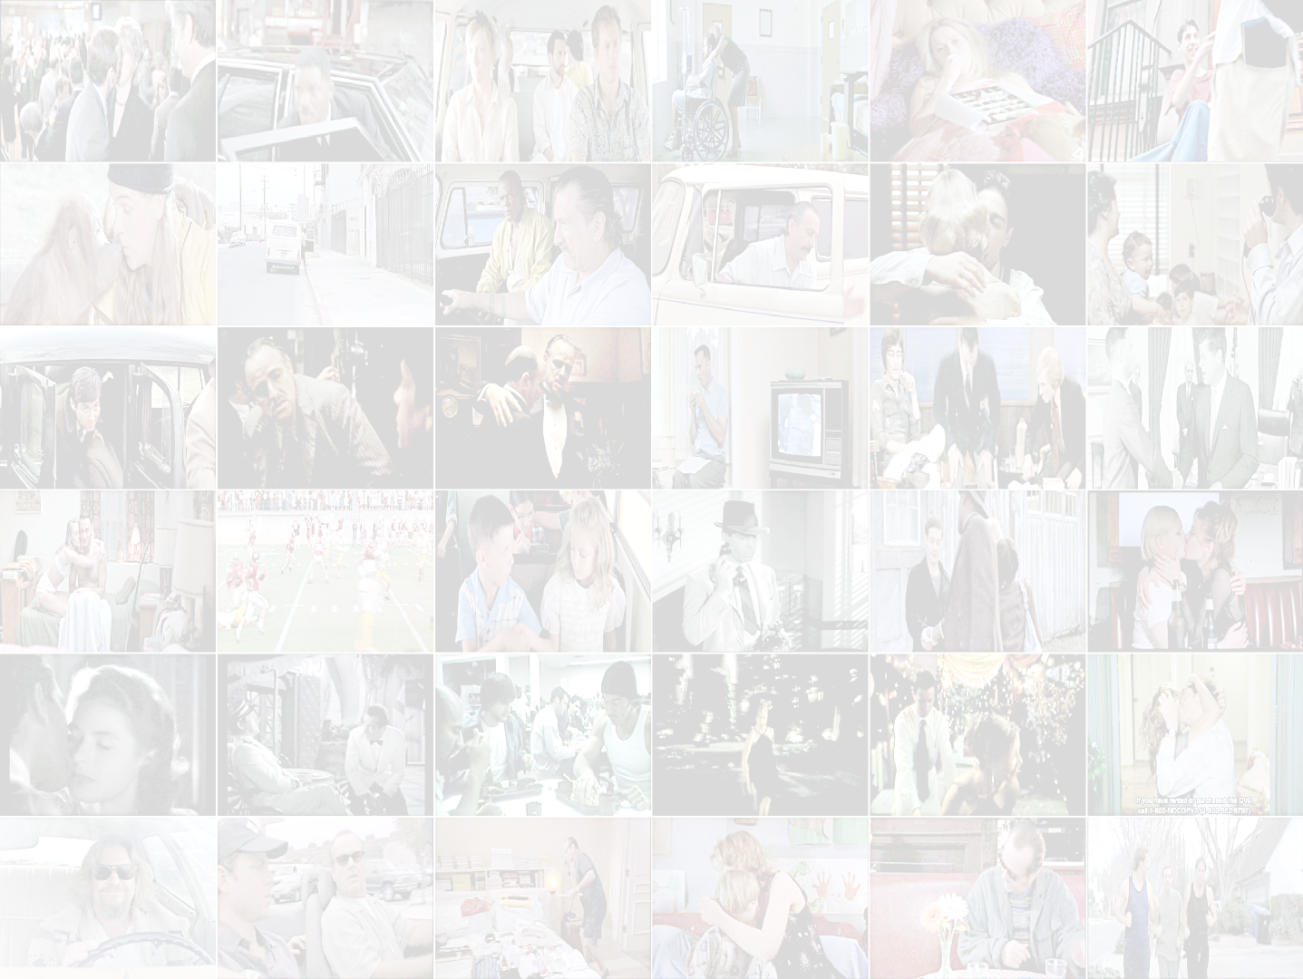
Structured Models for Action Recognition in Real-world Videos
Adrien Gaidon
TVPA – XRCE
work done @ LEAR, Inria Grenoble, 2008 - 2012
with Pr. Cordelia Schmid and Dr. Zaid Harchaoui
Notes:
This research was conducted at the LEAR team of INRIA Grenoble,
under the supervision of Cordelia Schmid and Zaid Harchaoui,
and with funding from the Microsoft research – INRIA joint center.

Slide 2
Introduction
General Goal
Automatic video analysis
=
Make computers interpret the content of videos
Here, content = Generic Human Actions
Notes:
Our goal in this thesis (click) is to allow computers to
automatically analyze and interpret the content of videos.
Here, the content we are interested in (click) is generic human actions
like running, kissing, or falling down.

Slide 3
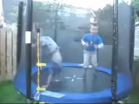
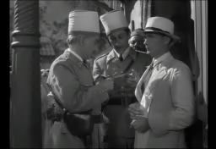

Introduction
Motivation
Massive amounts of video + huge growth
YouTube uploads: 35 hrs/min (2011), 75 hrs/min (2012)
Human actions = one of the main type of events
Automatic interpretation has many applications
indexing, robotics, video-surveillance, …
Notes:
So why do we need computers to analyze videos?
One of the main reasons is (click) because humans
just don’t have enough time to look at all the videos.
And the amount of data is increasing at an incredible rate.
Therefore, we need tools that can automatically process
this huge mass of data.
In particular, automatically recognizing human actions is especially important,
(click) as they are one of the main type of events of interest.
Most videos are indeed about people doing something.
(click) And being able to automatically recognize human actions
has many applications,
for instance in video indexing, robotics, or video-surveillance.

Slide 4

Introduction
Problem
Action Recognition in Real-world videos
Given labeled video examples
Classify unseen videos
Localize actions in long videos
fall
kiss
run
?
?
Notes:
In this thesis, we want to design computer programs that can automatically recognize
a certain number of human action categories in real-world videos.
(click) The input of our programs is called the training data,
and consists of a set of labeled video examples for which we know what actions they contain.
Our goal is to use this training data in order to learn to recognize these action categories.
There are two main recognition tasks we are interested in.
(click) The first one is called classification.
It consists in assigning an action label to new short videos in order to answer questions
like “Is someone falling down in this video?”
(click) The second recognition task we are interested in is called action localization.
This time, the goal is to extract small clips from a long video in order to answer questions like
“When is someone falling down in this video?”

Slide 5
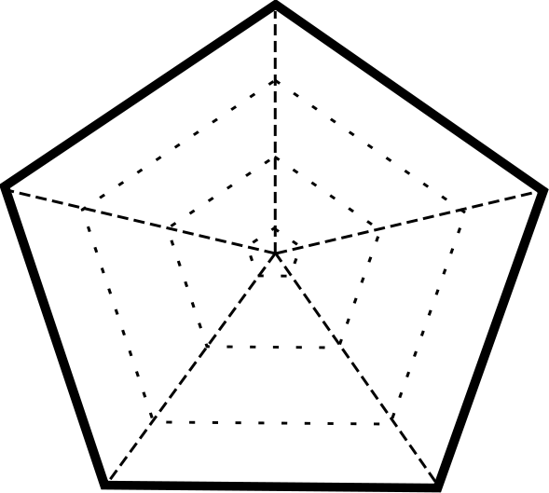
Introduction
Challenges
Recognition difficulty
Motion complexity
Visual complexity
#categories
Size
Notes:
As I mentioned before, our focus is on real-world videos.
This raises several interesting challenges.
First, real-world videos display a high degree of
visual variety and complexity.
Therefore, we need to be able to recognize actions
performed by any kind of actor in any kind of scene.
We also need to be able to deal with actions involving
complex motions of multiple limbs, people, objects,
and the camera itself.
Finally, we must also be able to recognize
many different action categories in a large number of videos.
Researchers have introduced several video benchmarks
in order to quantitatively evaluate action recognition methods
with respect to these challenges.

Slide 6
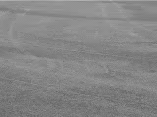
Introduction
Challenges
Recognition difficulty
ACC = Accuracy
Motion complexity
Visual complexity
100% ACC
KTH
6
C. Schüldt, I. Laptev,
and B. Caputo.
Recognizing human actions:
a local SVM approach.
In ICPR, 2004
2391
videos
#categories
Size
Notes:
One of the earliest recognition benchmarks is the KTH dataset.
(click) It consists of a small number of action categories
and controlled video data.
Note that the colored area measures the
overall complexity of the dataset.
Other similar benchmarks were proposed,
but performance on these simple datasets has now reached its peak.

Slide 7
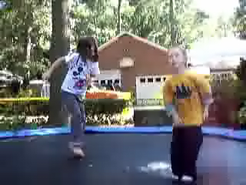
Introduction
Challenges
Recognition difficulty
ACC = Accuracy
Motion complexity
Visual complexity
84% ACC
1167
videos
Youtube
J. Liu, J. Luo, and M. Shah. Recognizing realistic actions from videos “in the Wild”.
In CVPR, 2009
11
#categories
Size
Notes:
Therefore, the research community
has moved to more complex videos and actions,
like YouTube videos.
(click) As you noticed, there are compression artifacts
and other sources of visual complexity
that makes it difficult to recognize actions in those videos.

Slide 8
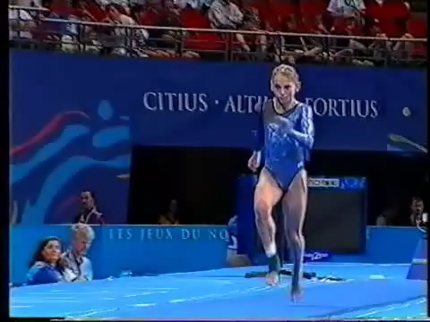
Introduction
Challenges
Recognition difficulty
ACC = Accuracy
Motion complexity
77% ACC
Visual complexity
783
videos
Olympics
J. C. Niebles, C.W. Chen,
and L. Fei-Fei.
Modeling Temporal Structure of Decomposable Motion Segments for Activity Classification.
In ECCV, 2010
16
#categories
Size
Notes:
Sports videos, like those from the Olympic Sports dataset,
provide another source of challenge.
(click) Indeed, the recognition difficulty here
stems mostly from the complex motions involved in sports activities.

Slide 9

Introduction
Challenges
Recognition difficulty
AP = Average Precision
58% AP
Motion complexity
Visual complexity
Hollywood 2
1873
videos
M. Marszalek, I. Laptev,
And C. Schmid.
Actions in context.
In CVPR, 2009
12
#categories
Size
Notes:
Even more complex action videos can be obtained from movies,
as is the case for the Hollywood 2 dataset.
(click) Due to the large visual variability across movies,
recognition difficulty is even higher on such data.

Slide 10

Introduction
Challenges
Recognition difficulty
ACC = Accuracy
26% ACC
Motion complexity
Visual complexity
HMDB
H. Kuehne, H. Jhuang, E. Garrote, T. Poggio, and T. Serre.
HMDB: a large video database for human motion recognition.
In ICCV, 2011
6783
videos
51
#categories
Size
Notes:
Finally, one of the most challenging datasets to date is HMDB
(click) It consists of a large number of actions
and videos coming from different sources,
like YouTube, movies, and TV archives.
However, the action categories are fairly simple
and the recognition difficulty stems mostly
from the large scale of the dataset.
Note that none of the benchmarks alone
spans the entire spectrum of challenges.

Slide 11
Introduction
Challenges
Recognition difficulty
Motion complexity
Visual complexity
#categories
Size
Notes:
Therefore, we conducted experiments by using different datasets
in order to test the general efficiency and robustness of our methods.

Slide 12
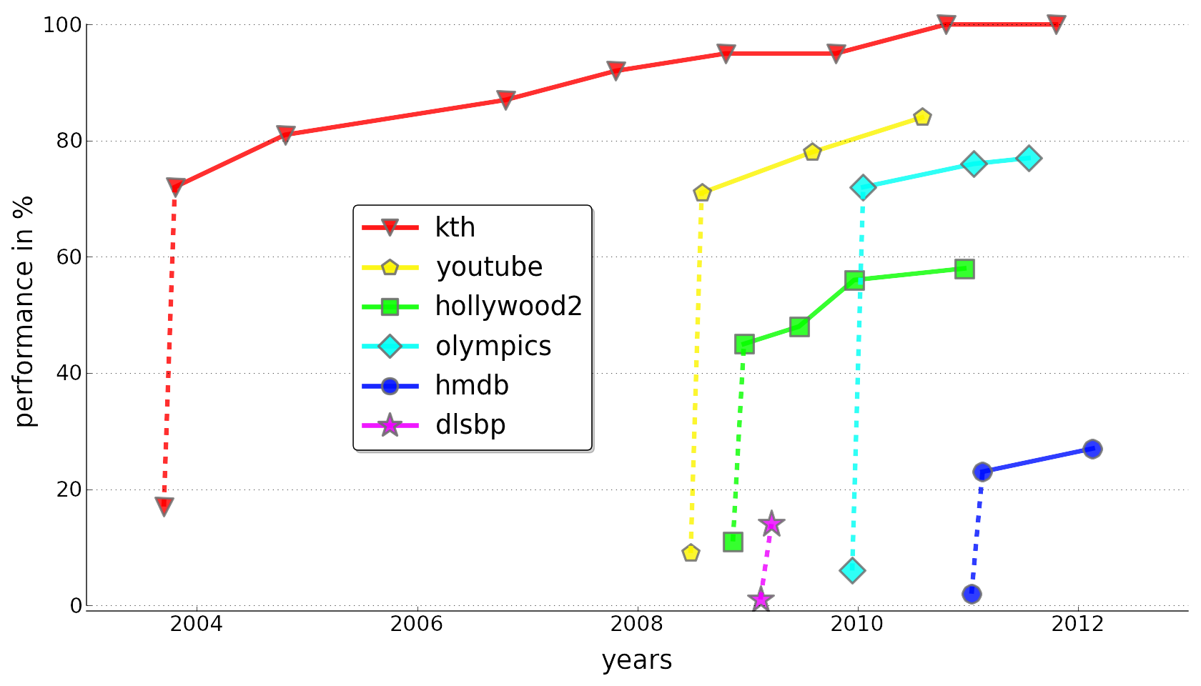
Introduction
Context
Notes:
This plot depicts the progress of the computer vision community
on the action recognition problem.
Recognition performance is on the y-axis, while years are on the x-axis.
Each curve represents one of the datasets I mentioned earlier.
I also added the DLSBP dataset which is used
to evaluate action localization,
whereas all other datasets are designed for classification.
Each point corresponds to the recognition performance
of the state of the art method at the time on a particular dataset.
The left-most point of each curve represents
the performance of a random classifier.
This performance is also called the chance level.
So let me break this plot down for you.

Slide 13
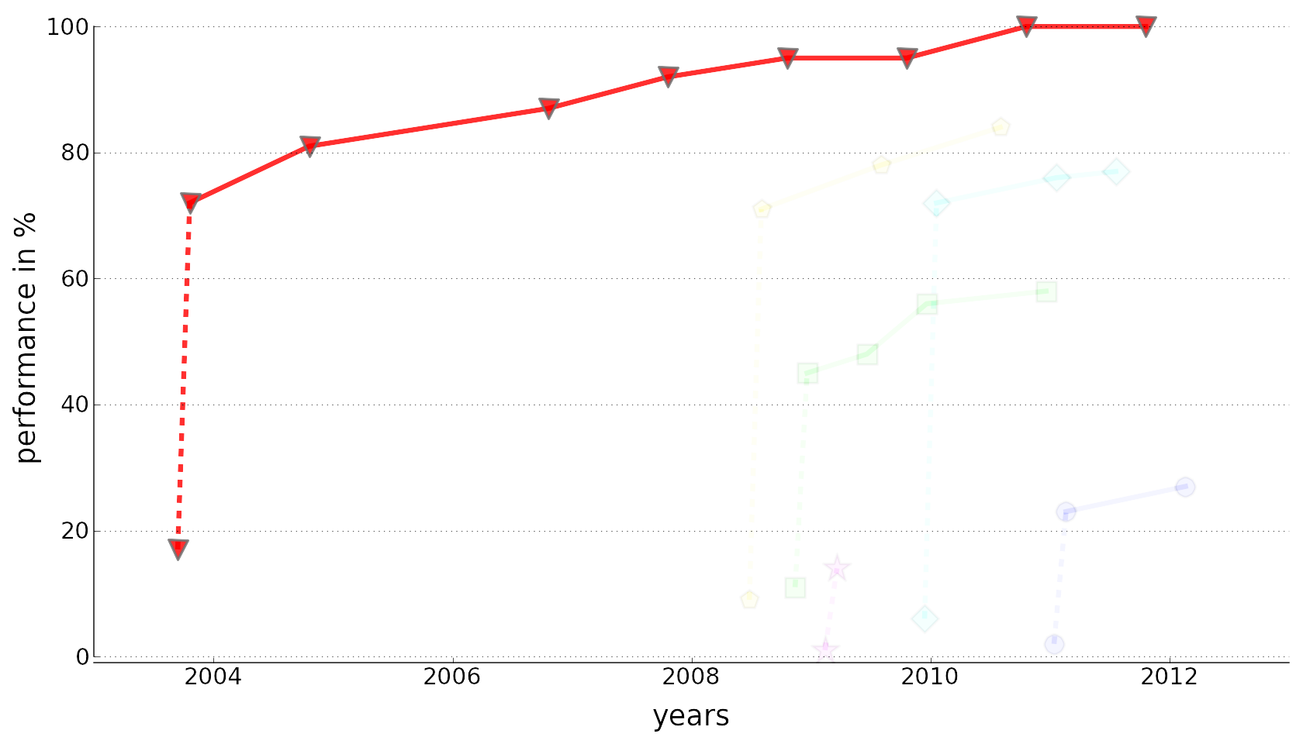
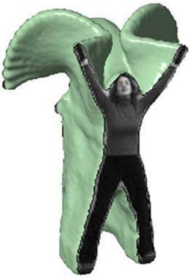
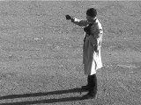
Introduction
Context – Simple data
KTH
Notes:
The first benchmarks, like the KTH (click) dataset,
consisted of simple controlled videos shot for, by,
and with computer vision scientists.
(click) Global representations based on silhouettes
proved to be very efficient on this data.
However, these methods are in general not applicable
to more complex actions and videos (click)…

Slide 14
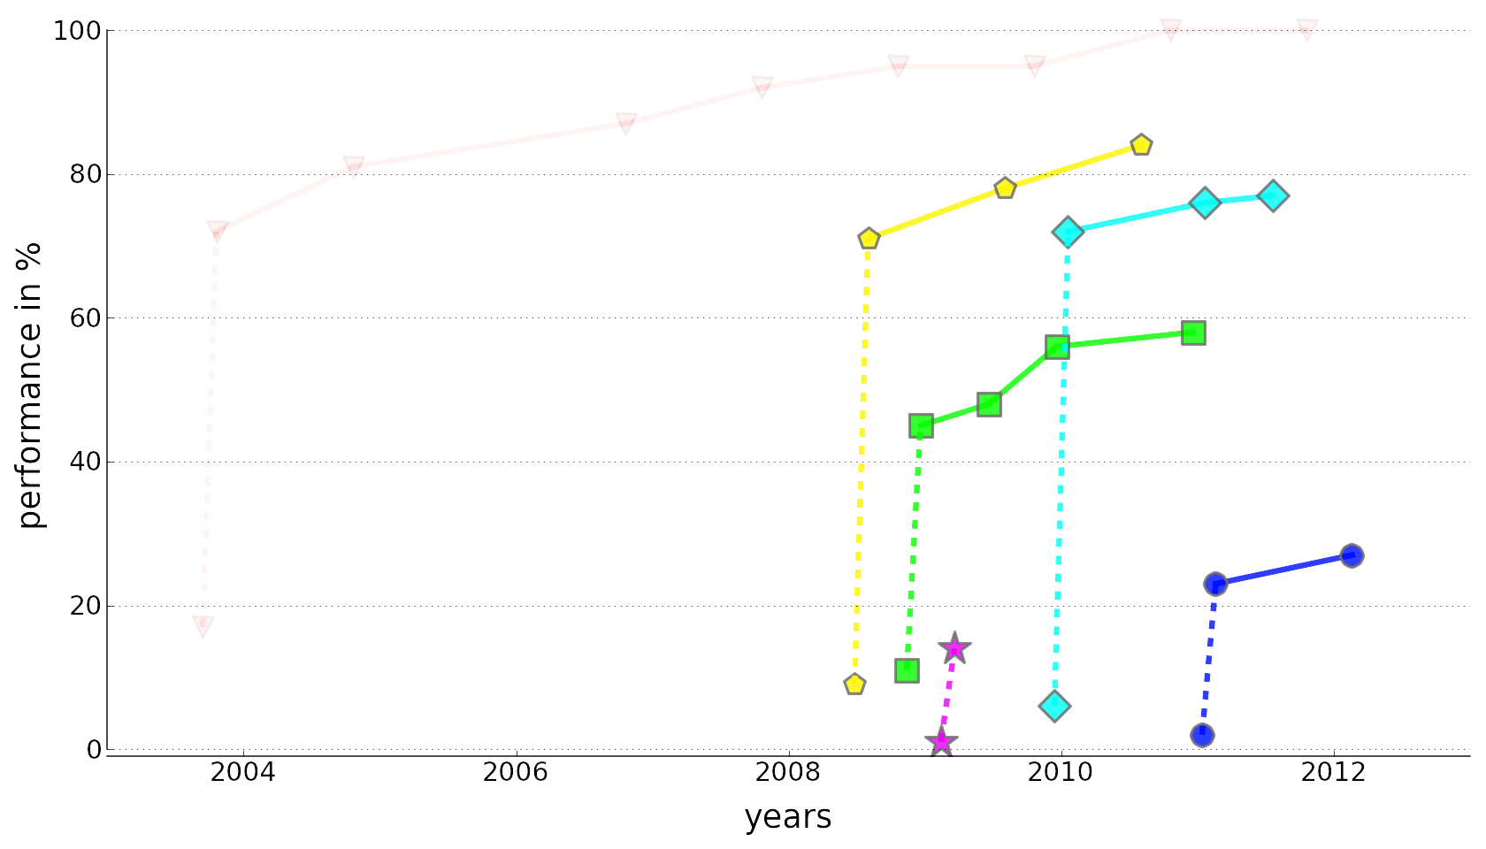

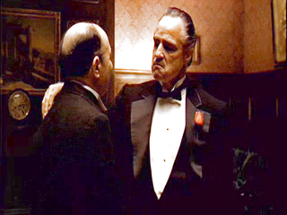
Introduction
Context – Movies & TV
Hollywood 2
Notes:
… like movies or TV archives.
What proved to be efficient on this much more challenging data
are approaches describing videos as sets of local features (click),
like small video sub-volumes corresponding to
spatio-temporal interest points (laser)
or local point trajectories (laser).
One of the most robust action models using local features
is called the Bag-of-Features or (BOF).
This is one of the baseline methods we compare to, and consists
in aggregating local features into a fixed-length histogram.
This method does not make any global assumptions about the action.
That’s why BOF is robust to challenging video conditions.
But the problem is that it discards important structure information.

Slide 15
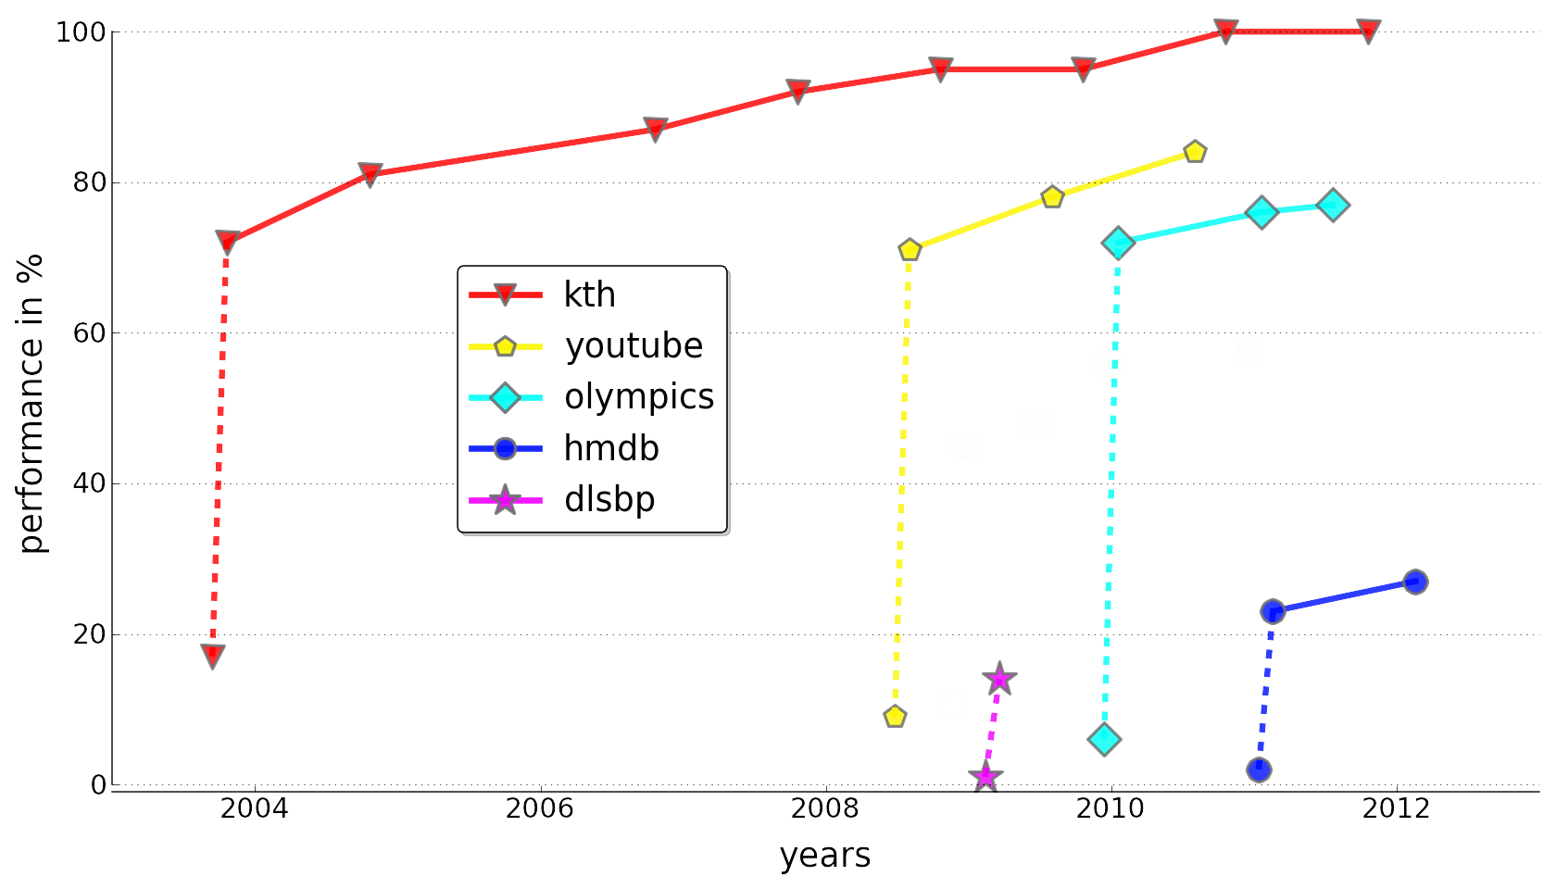
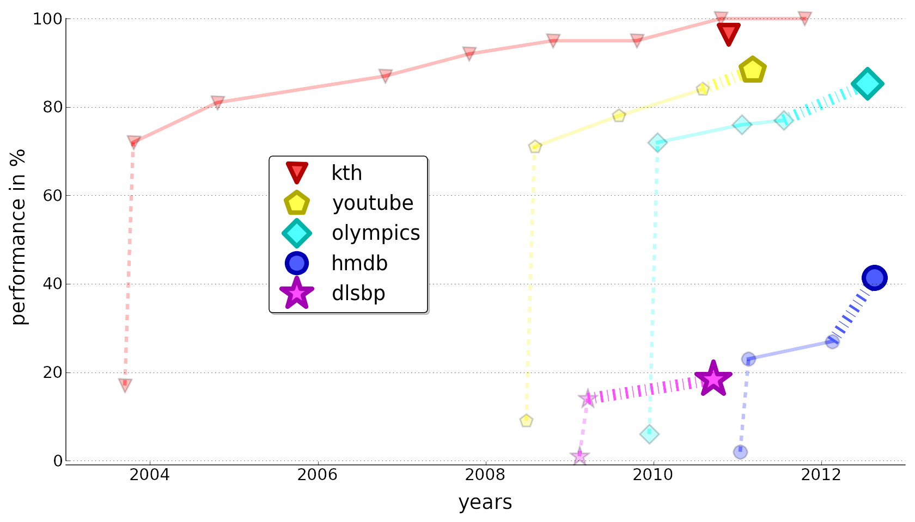
Introduction
Context – This Thesis
Notes:
In this thesis (click), we propose an alternative set of models,
(click) which outperform BOF and compare favorably
to the state of the art and other related works
that I will describe in the different parts of this presentation.
Note that these results here are just some of the results I will present.

Slide 16
Introduction
Overall approach
Working assumption: actions are characterized by spatiotemporal relations between sub-events
Claim: both the content and the structure information are important in real-world videos
Strategy: organize collections of local features
Notes:
So how do we achieve this good performance?
Our methods all rely on the same underlying hypothesis.
(click) We make the assumption that actions are
characterized by spatiotemporal relations between sub-events,
(click) and we claim that both the content and the structure information
are important in real-world videos
(click) So in our work,
we propose to leverage this hypothesis
by modeling actions as organized collections of local features.

Slide 17
Introduction
Questions to answer
What are good units to decompose actions on?
What is the interesting structure of actions?
How to robustly extract and represent structure?
How to learn and compare structured models?
Notes:
This strategy raises several interesting questions
that our methods propose to answer:
What are…

Slide 18
Outline
Learning temporal structure for action localization
Comparing the temporal dynamics of actions
Hierarchical motion decomposition of activities
Summary & Future work
Notes:
In the following, I will detail the three main contributions of this thesis.
First, I will describe how to learn the temporal structure of actions.
Second, I will show how to compare the temporal dynamics of actions.
Finally, I will address the issue of modeling complex activities
using motion hierarchies.

Slide 19
Outline
Learning temporal structure for action localization
Comparing the temporal dynamics of actions
Hierarchical motion decomposition of activities
Summary & Future work
Notes:
In this first part, I will be talking about the problem of action localization.

Slide 20
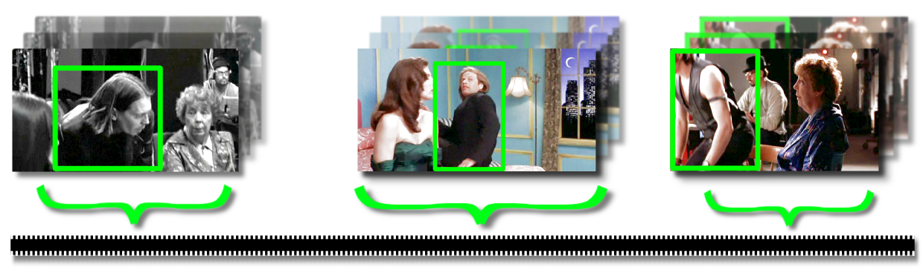
Action Localization
Problem
Find if and when an action is performed in a video
Long un-segmented video sequences (several hours)
Temporal localization: find clips containing the action
Notes:
As I said previously, action localization consists in finding if and when
an action is performed in a long video, for instance a movie.
In particular, we want to extract all short clips
containing a simple query action like sitting down.

Slide 21
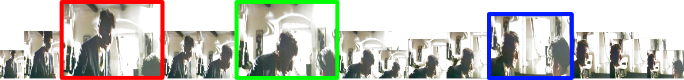
Action Localization
Proposed Approach
Use the global temporal structure of actions
Model as sequences of “action atoms” (actoms)
Notes:
For that, we propose (click) to use the global temporal structure of actions
in order to model them as (click) sequences of « action atoms ».
These actoms correspond to temporal parts (click x 4),
which I will describe later on.

Slide 22
Action Localization
Related Work
Bag-Of-Features (BOF)
  Coarse rigid structure with spatio-temporal pyramids [Laptev et al. CVPR’08]
  Sliding window and BOF with automatic refining of temporal boundaries
  [Duchenne et al. ICCV 2009; Satkin & Hebert, ECCV 2010]
Temporal structure of long-duration activities
  Loose hierarchical structure of latent motion parts [Niebles et al. ECCV’10]
  Dynamic Bayesian Networks with high-level hierarchies [Laxton et al. CVPR’07]
Facial action recognition
  Action Unit (AU) detection with structured learning of temporal segments [Simon et al. CVPR’10]
Notes:
(click) Our approach is related to several works aiming to address
some of the shortcomings of the bag-of-features
by using more structure information.
(click) Several researchers have also studied the temporal structure
of longer duration activities using probabilistic or latent part models.
In contrast, we propose a simpler approach for the localization of short actions.
(click) Finally, our method shows some connections
with works on action unit detection for facial action recognition.

Slide 23
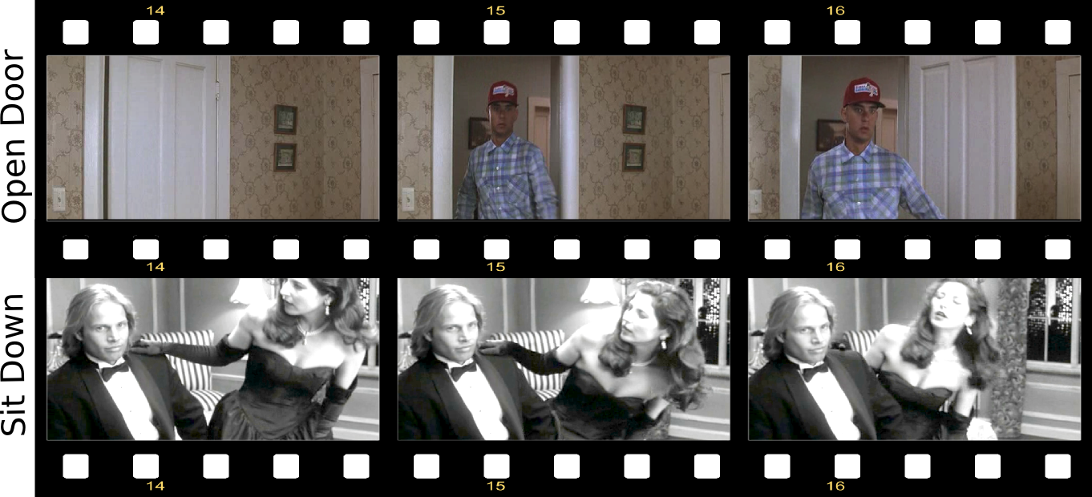
Actoms
Definition
Temporal parts corresponding to meaningful action units
Action specific sub-events
Whose sequence is characteristic of the action
Notes:
As I said before, our approach consists in
modeling actions using a sequence of « actoms ».
So what are these actoms?
(click) They are temporal parts corresponding to meaningful action units.
To be more precise, they are (click) action specific sub-events
(click) whose sequence is characteristic of the action.
(click) Here are for instance two example actions,
opening a door and sitting down,
with three actoms each.
You can clearly see that the temporal parts for opening a door
are not shared by the ones for sitting down.
Furthermore, reversing the temporal ordering also changes
the interpretation: opening a door becomes closing a door for instance.

Slide 24
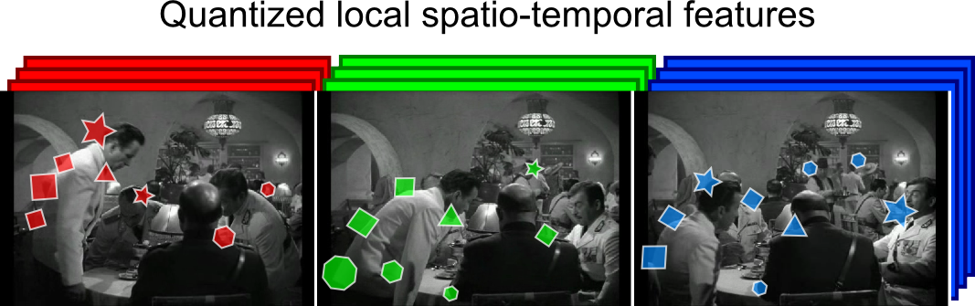
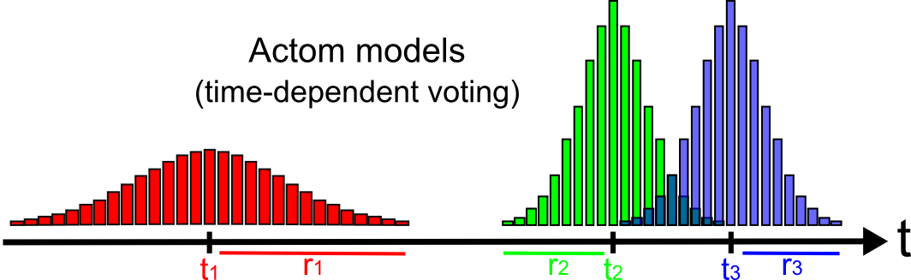
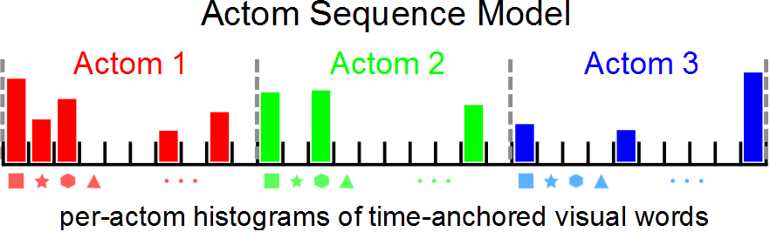
Actom Sequence Model (ASM)
Action descriptor
Notes:
We rely on this temporal decomposition to represent actions
using what we call the Actom Sequence Model.
(click) Starting from a video,
here a sitting down action with three actoms,
we extract a set of quantized local spatio-temporal interest points.
(click) We then aggregate these features in order to build
a sequence of per-actom histograms.
This yields our Actom Sequence Model,
which can be interpreted as a temporally structured extension of BOF.
The per-actom aggregation of the local features
is performed according to (click) actom models.
They define time-anchored soft voting functions
that quantify how important is each frame for each actom.
The central frame of actoms -- t1, t2 and t3 here –
are obtained manually on the training videos.
However, actoms are automatically detected at test time
using a method I will describe later

Slide 25
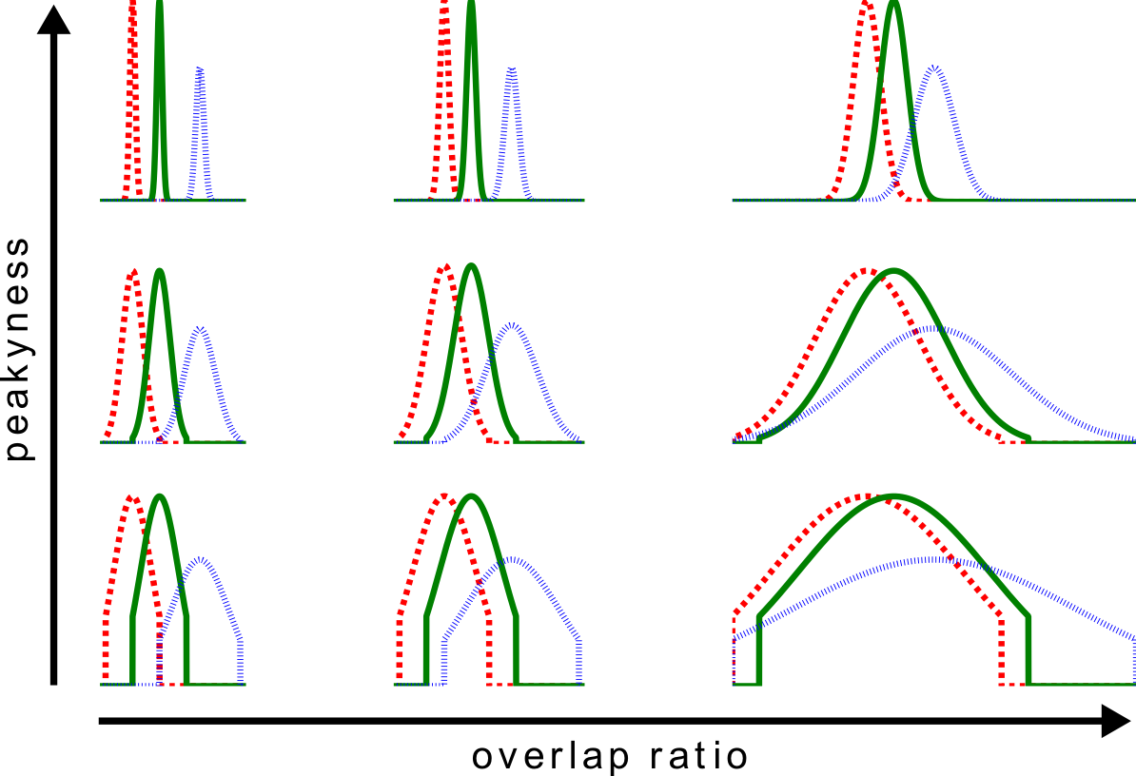
Actom Sequence Model (ASM)
Robust parameterization
Overlap ratio between adjacent actoms (controls radius)
Soft-voting “peakyness” (controls profile)
Keyframe-like
BOF-like
Notes:
A key aspect of ASM is our robust parameterization
of the time-dependent voting functions.
We use only 2 hyper-parameters with the same values
for all actom sequences in all videos:
(click) the overlap ratio between adjacent actoms,
which defines an adaptive time-span for actoms,
(click) and the peakyness,
which controls the profile of the soft-voting functions.
(click) Here you can see the impact of these parameters on
the actom models, which can vary from sequences
of keyframes to BOF-like models.
(TRANSITION)
So we have defined our Actom Sequence Model,
which represents an action using a temporally structured histogram.
Now I am going to describe how we use this model
for automatic temporal localization of actions.

Slide 26
Training
Action classifier
ASM classifier (non-linear SVM on ASM representations)
  estimates posterior probability of an action
  knowing the temporal location of its actoms
Actoms unknown at test time
use training examples to
learn actom candidates
Notes:
First of all, (click) we learn an ASM classifier.
As ASM is a histogram, we can use standard
machine learning tools like a kernel SVM.
You can choose the classifier you want, but what matters is
(click) that this classifier estimates
the posterior probability of an action,
knowing the temporal location of its actoms
The problem is that (click) actoms are unknown at test time,
Therefore, (click) we propose to use the annotations
on the training examples in order to learn a set of actom candidates.

Slide 27
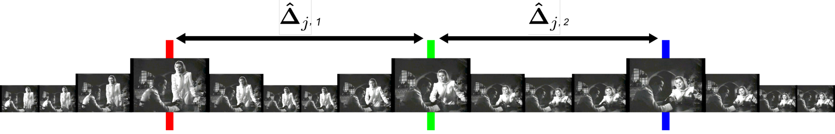
Training
Prior on temporal structure
Temporal structure: inter-actom spacings
Non-parametric model of the temporal structure
  kernel density estimation over inter-actom spacings from training action examples (multivariate continuous distribution)
  discretize it to
prior on temporal structure
t₁
Δ₁
t₂
Δ₂
t₃
Notes:
More precisely, we learn a generative model of the temporal structure,
(click) where the temporal structure of an action
is defined as its inter-actom spacings.
On this sitting down example with three actoms,
the inter-actom spacings are delta1 and delta2 (laser).
(click) We learn a non-parametric distribution
on these relative temporal placements of actoms.
For that, (click) we first use kernel density estimation
on the inter-actom spacings from the training action examples.
(click) After a discretization step, we obtain a distribution D-hat,
which contains a set of K likely candidate structures (laser)
with their estimated probabilities (laser).
(click) We use this Delta-hat distribution
as a prior on temporal structure during localization.

Slide 28
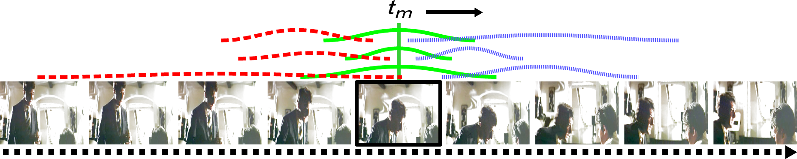
Automatic Temporal Localization
Sliding central frame
Probability of action at frame t_{m} by marginalizing over all learned candidate actom sequences
Sliding central frame: detection in a long video stream by evaluating this probability every N frames (N=5)
Notes:
Now that we have learned an ASM classifier
and a distribution on relative actom placements,
(click) we can compute the probability of
an action happening at time t_m in a video
(click) by marginalizing over all learned candidate actom sequences.
The posterior here (laser) is given by our ASM classifier,
and the prior here (laser) is given by our generative temporal model.
(click) We can then localize an action in a long video
by computing this probability every N frames.
This what we call the sliding central frame approach.

Slide 29
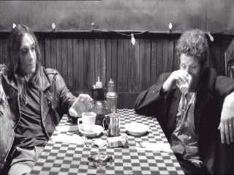
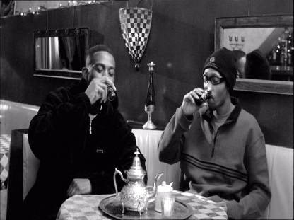
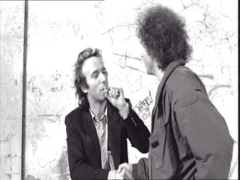
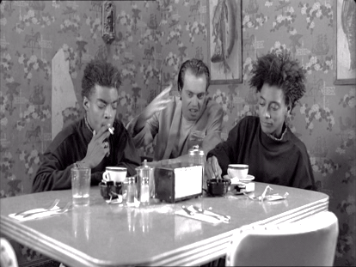
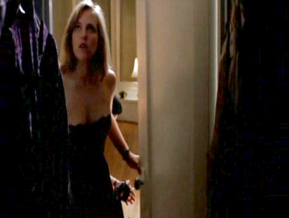
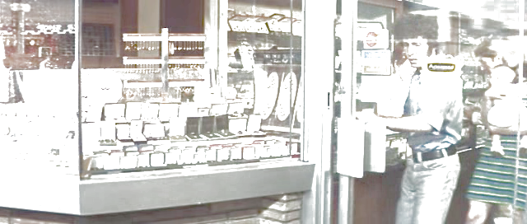
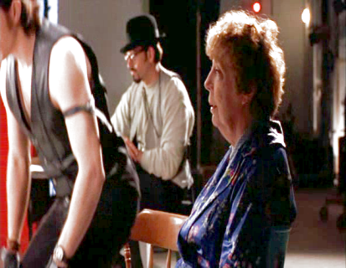
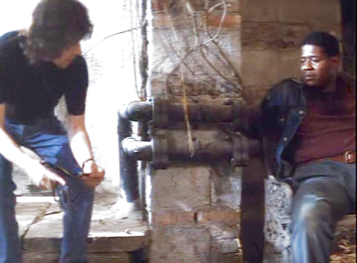
Datasets
« Coffee & Cigarettes »: drinking and smoking in 36 000 frames [I. Laptev and P. Perez. Retrieving actions in movies. In ICCV, 2007.]
« DLSBP »: opening a door and sitting down 443 000 frames
[O. Duchenne, I. Laptev, J. Sivic, F. Bach, and J. Ponce. Automatic annotation of human actions in video. In ICCV, 2009.]
Notes:
In order to quantitatively evaluate our approach,
we conducted several experiments
on challenging localization benchmarks using movies.
(click) First, …
(click) The second …

Slide 30
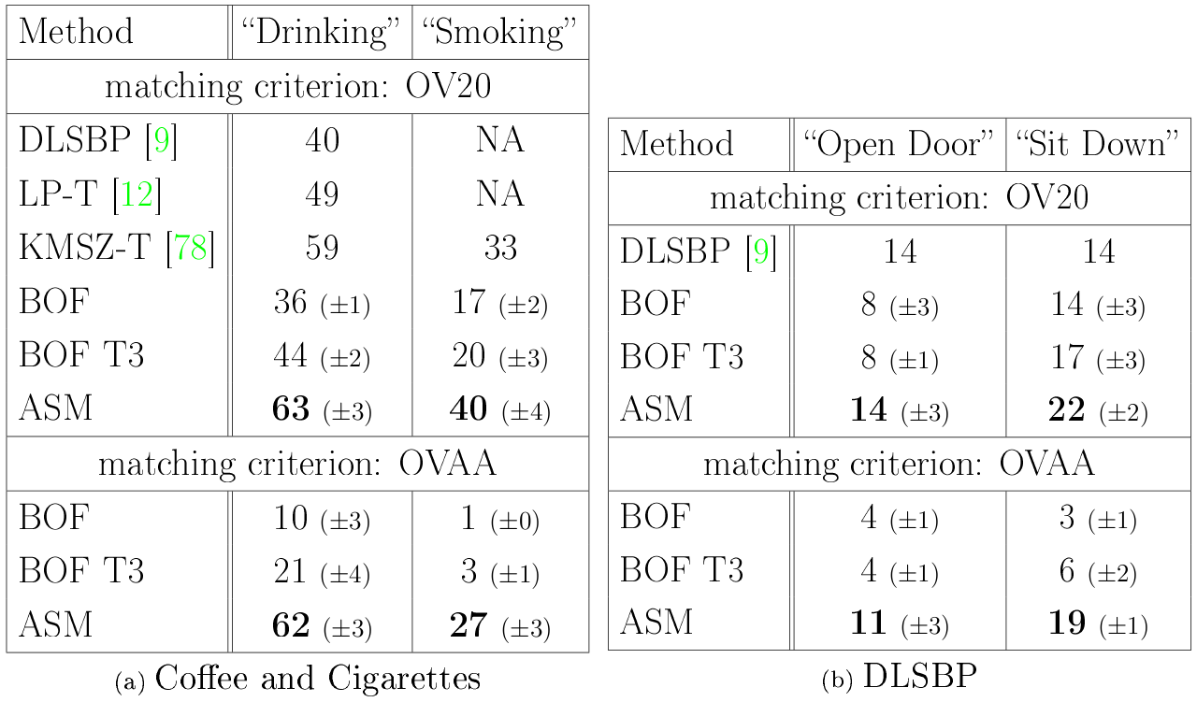
Quantitative results
Localization performance
Notes:
Perf = ap in %
Our ASM method (click), here in red,
outperforms all baselines
based on the standard BOF representation
(click) here in yellow.
ASM also improves over the state of the art (click)
including more sophisticated methods using a tracker
ASM is better than rigid temporal structure,
For instance the spatio-temporal pyramid extension of BOF.
Finally, we conducted additional classification experiments
on the Hollywood 2 dataset
to show that our localization approach can be generalized
to a classification by detection scenario
with the same conclusions.

Slide 31

Qualitative Results
Action-oriented summary

Slide 32
Conclusion
ASM: efficient model of actions with a flexible
sequence of meaningful sub-actions (actoms)
Sliding central frame > Sliding window thanks to its
prior on temporal structure
ASM outperforms bag-of-features, rigid temporal
structures, and the state of the art
Actom Sequence Models for Efficient Action Detection,
Adrien Gaidon, Zaid Harchaoui, Cordelia Schmid
CVPR 2011
Action detection with Actom Sequence Models
Adrien Gaidon, Zaid Harchaoui, Cordelia Schmid
INRIA Tech. Report (submitted to PAMI)

Slide 33
Outline
Learning temporal structure for action localization
Comparing the temporal dynamics of actions
Hierarchical motion decomposition of activities
Summary & Future work
Notes:
In the first part, we saw how to learn the temporal structure of actions.
In this second part, I will talk about comparing the temporal dynamics of actions.

Slide 34
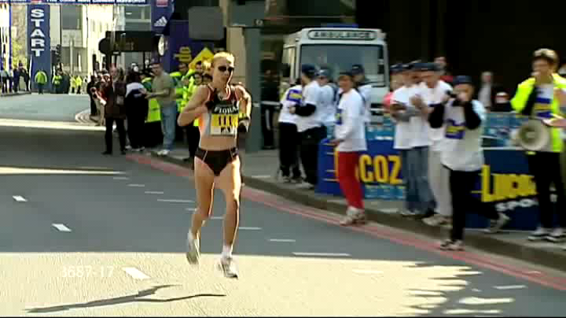
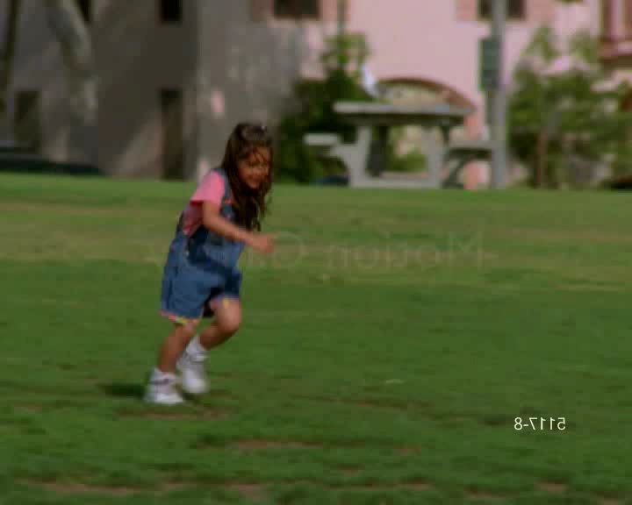
Comparing the dynamics of actions
Problem
Supervised action classification in videos
Need a good similarity (kernel) between videos
fall
kiss
?
run
?
?
Notes:
This time, we’re not localizing actions anymore.
(click) Instead, we wish to learn a classifier of pre-segmented videos
from a set of labeled training ones.
Classifiers need to be able to compare the content of videos,
and therefore (click) we need to define a good similarity -- or kernel -- between videos.

Slide 35
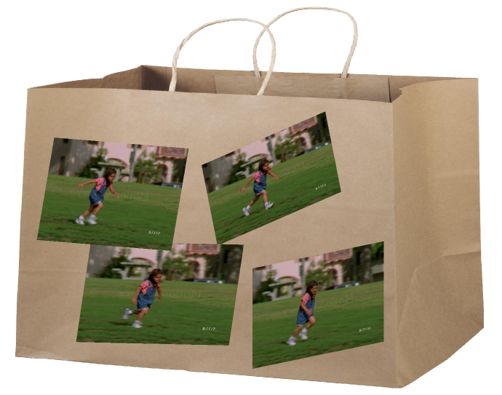
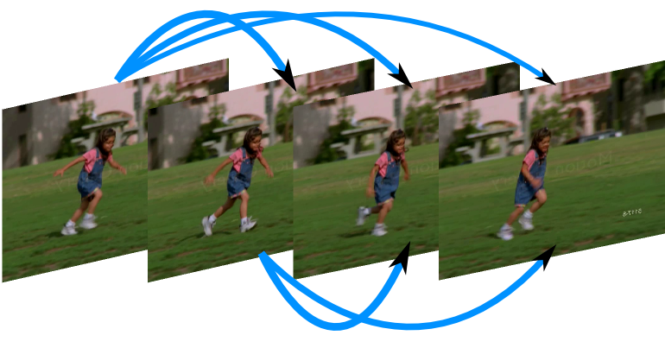
Comparing the dynamics of actions
Proposed approach
State of the art:
similarity between average over frames
Our approach:
Combine
with temporal dependencies
+
Notes:
(click) The current state-of-the-art methods often rely on comparing average over frames.
This is the case for the bag-of-features model for instance.
This works already quite well, and as they say in software engineering:
« if it’s not broken, then don’t fix it »
Therefore, instead of replacing this method altogether,
we propose to (click) combine it,
with another Complementary source of information
that is not captured by averages:
namely (click) the temporal dependencies.

Slide 36
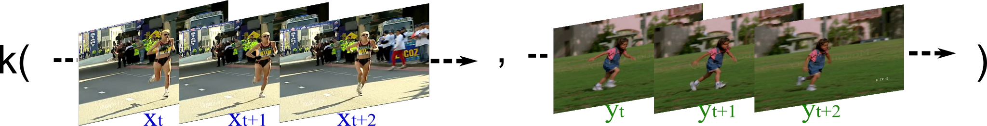
Comparing the dynamics of actions
Contributions
Model actions as time series of frames
Define a time series kernel comparing dynamics
Represent action dynamics by auto-correlations
Notes:
(click) We start by modeling actions as time series of frames.
(click) We then propose a time series kernel that compare the dynamics of actions.
(click) And in our case, the dynamics are represented by auto-correlations.

Slide 37
Comparing the dynamics of actions
Related work
Cross-correlation-based alignment
  Shape and flow cross-correlation [Ke et al. CVPR’07]
  Action MACH filter [Rodriguez et al. CVPR’08]
  Tensor-CCA between video volumes [Kim & Cipolla PAMI’08]
Speech and gesture recognition
  Actions as sequences of states e.g. [Brendel & Todorovic ECCV’10]
  Dynamic probabilistic graphical models e.g. [Yamato et al. CVPR’92]
Kernels on time series
  Alignment based on Dynamic Time Warping [Cuturi et al. ICASSP’07, ICML’11]
  Functional Bregman divergence between expectations of GP models
  [Lu et al. ICML’08]
Notes:
(click) Auto-correlations are different from cross-correlations,
which have been used in order to measure the alignment between videos.
(click) Our method also differs from generative state-based approaches
influenced by the more constrained fields of speech and gesture recognition.
(click) Finally, note that other kernels on time series exist.
However, most of them measure only alignments.

Slide 38
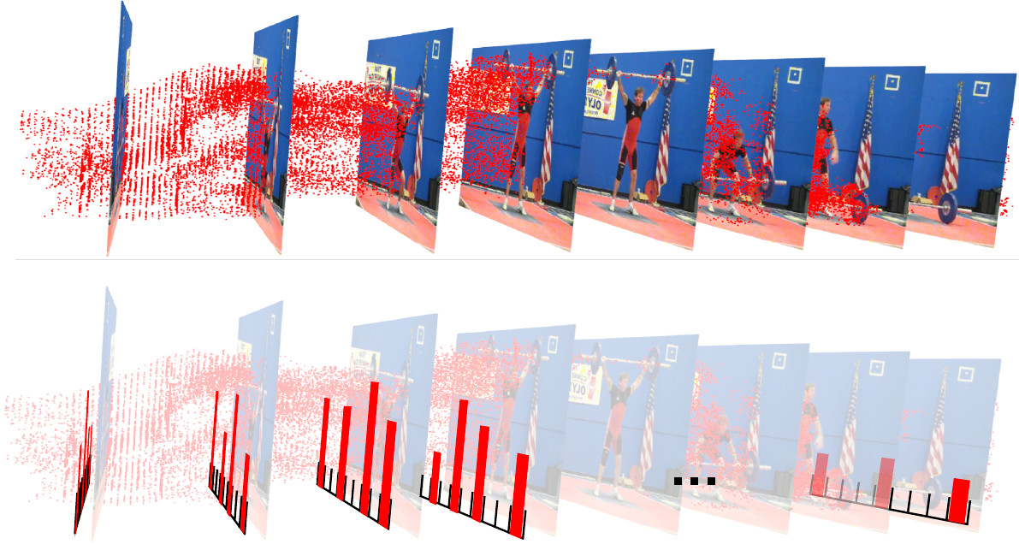
Actions as time series of frames
Frame representation
State-of-the-art local video features: tracklets
[Wang et al. CVPR’11]
Per-frame Bag-of-Features (BOF) of tracklets
Base kernel between frames (intersection kernel)
Notes:
As I said before we’re going to model the dynamics
of an action using its auto-correlation.
The first step consists in representing a video
as a time series of frame descriptors.
(click) We first extract local video features.
We use the state of the art tracklets of Wang et al. at CVPR’11.,
which correspond to fixed-duration point trajectories
sampled over a dense spatial grid.
(click) We then obtain our time series representation
by computing a bag-of-features for each frame.
This means that a frame is modeled as
a histogram of the tracklets intersecting this frame.
Note that we do not depend on this particular frame representation
and our method can be applied on any kind of frame model.
The only thing we need is a kernel, or similarity measure, between frames.
In our case, (click) we chose a standard kernel on histograms,
called the intersection kernel.

Slide 39
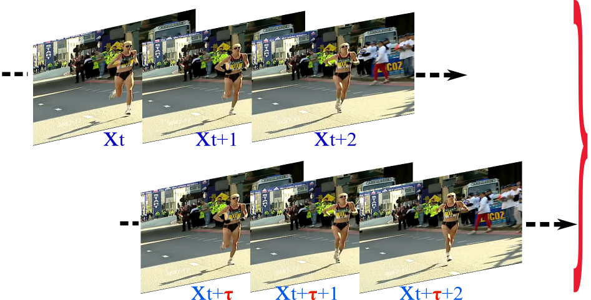
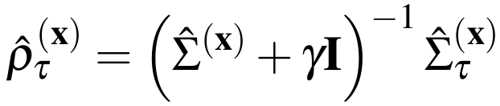
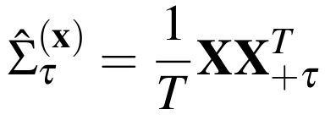
Auto-correlation operator
Definition
Auto-correlation: normalized cross-covariance
between a time-series and a shifted version of itself
γ: regularization constant
τ : time-lag parameter
Notes:
As I said, we represent the dynamics of an action using its auto-correlation.
(click) It is defined as the normalized cross-covariance
between a time series (laser)
and a shifted version of itself (laser).
Here is the cross-covariance (laser),
and here is the normalization factor (laser).
As you can see there are two parameters:
(click) gamma, which is a regularization constant
set by cross-validation,
and (click) tau, the time lag parameter, which is set to 1 frame
for reasons described in the manuscript.

Slide 40
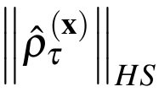

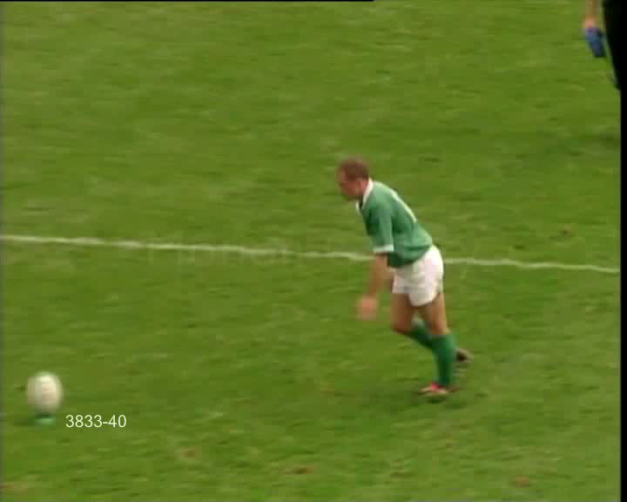
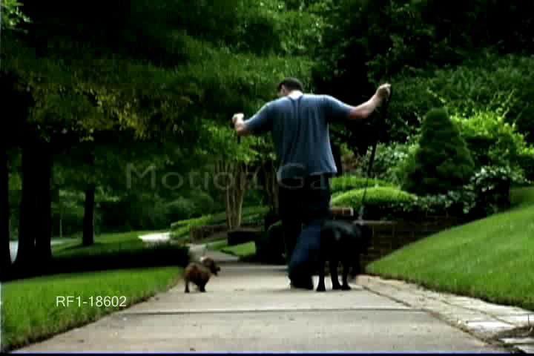
Auto-correlation operator
Interpretation
measures statistical dependencies
between frames over time
(Hilbert-Schmidt norm derives from the inner product: )
Video with low HS norm
Video with high HS norm
Notes:
Let me give you an intuition for why the auto-correlation models the temporal structure of an action.
(click) the natural norm of the auto-correlation
measures the statistical dependencies between frames over time,
such as pattern repetitions for instance.
(click) In this video, you have a rugby player kicking a ball.
The action involves fast motions that are difficult to relate to each other.
This results in a low norm of the corresponding auto-correlation.
(click) In contrast, this second video of a man walking his dogs
has much clearer temporal dependencies, resulting in a high norm.
(TRANSITION)
So we can represent an action using its auto-correlation.
HSIC: HS norm of cross-cov of x, y is 0 iff x, y are indep
Q: Impact of duration on HS norm?

Slide 41
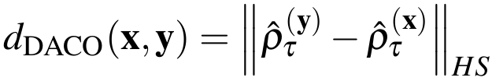
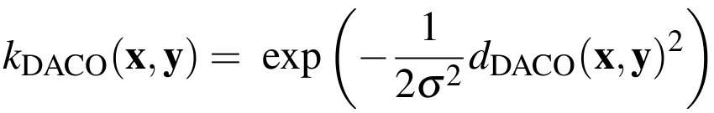
DACO kernel
Difference of Auto-Correlation Operators
Computational complexity:
cubic in the dimension of the frame feature space
(might be infinite!)
Solution: kernel trick!
Notes:
We propose therefore a kernel that compares two videos
by comparing their auto-correlations.
We introduce the kernel called the
Difference of Auto-Correlation Operators, DACO in short.
(click) It compares the dynamics of two time-series,
two videos x and y,
using the norm of the difference
between their respective auto-correlations.
(click) We can transform the DACO distance
into a similarity like this (laser).
And the great thing about this kernel
is that it works for series with different durations, periodic or not, etc.
But evaluating it *directly* like this is not feasible.
(click) Its computational complexity is indeed cubic
in the dimension of the frame feature space,
which might be infinite!
However, (click) we can use the kernel trick to come up with
a more practical formulation of DACO.

Slide 42
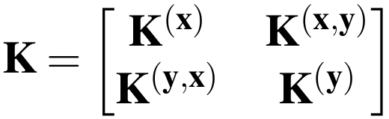

DACO kernel
Dual formulation
Rewrite with only kernel evaluations between frames
Dual formulation:
Much smaller complexity: cubic in number of frames!
Notes:
The kernel trick consists in (click) rewriting DACO
using only kernel evaluations between frames.
Here, the K matrix contains the pairwise similarities between
the frames of video x (laser),
the frames of video y (laser),
and between the frames of x versus y (laser).
(click) In the manuscript, we show how we can rewrite DACO
using only this kernel matrix K (laser).
Here (laser), the matrix N also only depends on K.
(click) What’s great is that we can use this expression in practice.
Its complexity is much smaller now:
it’s just cubic in the number of frames,
so it takes a just few milliseconds to compare two videos.

Slide 43
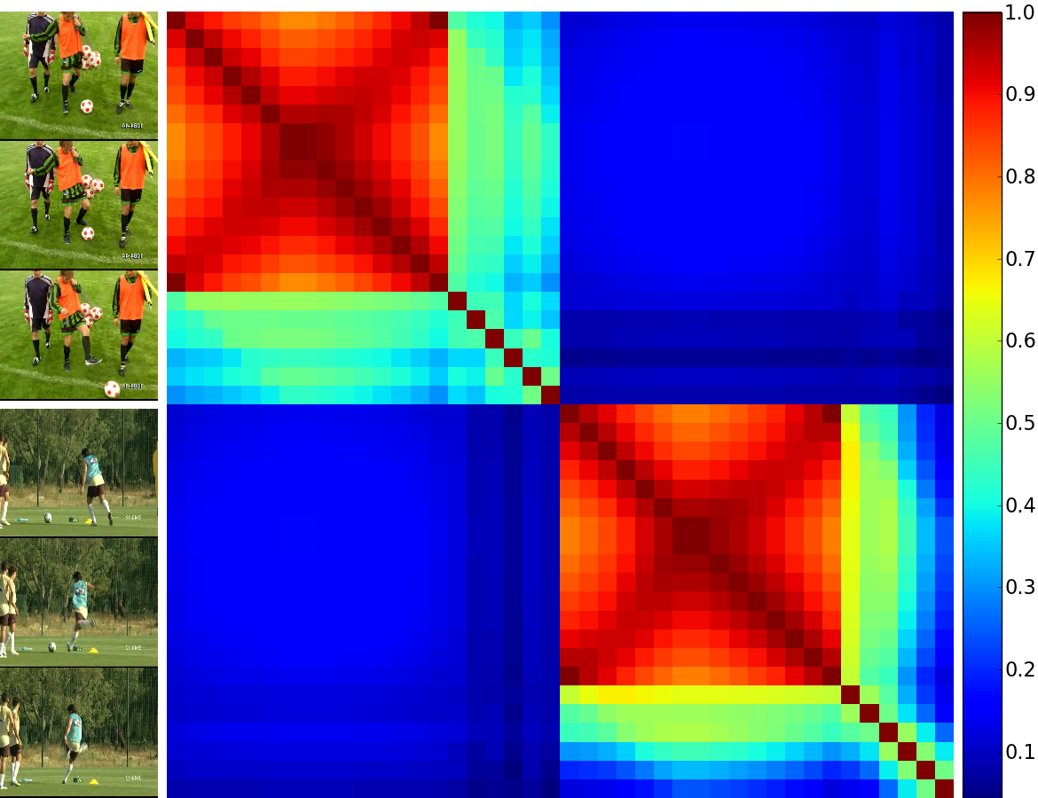
DACO kernel
Interpretation
Extracting temporal structure from self-similarity
same structures
high DACO similarity
Notes:
Another advantage of this dual expression is that it allows for a new interpretation of DACO.
(click) Indeed, it shows that comparing auto-correlations is a way to
extract structure information from the temporal self-similarity matrix
that I called K on the previous slide.
(click) Here you can see the K matrix for two ball kicking actions with a high DACO similarity.
Other researchers had already observed
that the diagonal blocks of this matrix share common structures.
Here the kernel trick allowed us to show that
extracting information from the whole K matrix
is equivalent to comparing the auto-correlations of the videos.
We conducted several action classification experiments
in order to test our DACO kernel.

Slide 44

Datasets
KTH
C. Schüldt, I. Laptev, and B. Caputo.
Recognizing human actions: a local SVM approach.
In ICPR, 2004
Notes:
The first dataset we use is the standard KTH dataset,
which contains a large number of video
but only simple periodic actions.

Slide 45

Datasets
UCF Sports
M. D. Rodriguez, J. Ahmed, and M. Shah.
Action mach: a spatio-temporal maximum average correlation
height filter for action recognition.
In CVPR, 2008
Notes:
We also used the more complex UCF Sports dataset,
which contains ten different sports action categories.

Slide 46

Datasets
Youtube
J. Liu, J. Luo, and M. Shah.
Recognizing realistic actions from videos “in the wild“.
In CVPR, 2009
Notes:
Finally, we also used the challenging YouTube videos
from the dataset of Liu et al.
This dataset is the most challenging of the three.
(not pictured: walking with a dog)

Slide 47



Combination with averaging kernel
Mean-element kernel
Goal: combine average statistics with dynamics
Averaging kernel: Difference between Mean-Elements
in the frame feature space
Can also be expressed with only kernel evaluations
DME + DACO: linear combination of the DME and DACO
kernels with cross-validated mixing weight
Notes:
As I said in the beginning of this section,
We don’t want to replace the efficient
averaging approaches that already exist.
(click) Our goal is instead to combine average statistics
with our kernel on temporal dependencies.
(click) As averaging kernel,
we use the Difference between Mean Elements,
DME in short.
It consists in comparing the means of the frames,
but in the frame feature space.
(click) We use this kernel, because it can also be expressed
as a simple function of the kernel matrix K, just like DACO,
and it tends to work a bit better than bag-of-features.
(click) Our goal is to find out if
the linear combination of DME and DACO,
noted DME + DACO,
improves over any kernel taken alone.

Slide 48



Experiments
Action classification in videos
KTH
UCF Sports
Youtube
Notes:
Here are the classification result
when we use these kernels
in conjunction with a SVM classifier.
The combination, (click) in red here,
improves over any kernel taken alone, (click) in yellow.
This shows that average statistics and temporal dependencies
are indeed complementary for action recognition.
(click) Note that the performance of DME+DACO
also compares favorably to the state of the art.

Slide 49
Conclusion
Auto-correlation models temporal dependencies
Extracts information from temporal self-similarities
Dynamics are complementary to average statistics
A Time Series Kernel for Action Recognition,
Adrien Gaidon, Zaid Harchaoui, Cordelia Schmid
BMVC 2011

Slide 50
Outline
Learning temporal structure for action localization
Comparing the temporal dynamics of actions
Hierarchical motion decomposition of activities
Summary & Future work
Notes:
Until now, I discussed only temporal aspects of simple actions.
In this third part, I will talk about the more complicated hierarchical structure of activities.

Slide 51

Recognizing complex activities
Problem
Supervised activity classification in videos
Activity: complex actions characterized by spatio-temporal relations between a variable number of parts
Goal: automatically identify motion components and exploit both their contents and their relations to improve recognition
Notes:
(click) The problem is still about learning a supervised classifier of videos.
(click) However, this time we are interested in activities.
By that, I mean more complex actions characterized by spatio-temporal relations between a variable number of parts.
(click) Our goal here, is to automatically identify these motion parts,
And exploit both the contents and relations to improve recognition.

Slide 52
Recognizing complex activities
Proposed approach
Describe motion content using dense tracklets:
fixed short duration point trajectories [Wang CVPR'11]
Hierarchically decompose the set of tracklets of a
video using divisive spectral clustering
SVM on tree-structured activity models using a
hierarchical kernel on nested histograms
Notes:
(click) The first step of our approach consists in representing the motion content of a video
by extracting its dense tracklets, the same local point trajectories I described in the previous section.
(click) Then we introduce a hierarchical clustering algorithm in order to organize the set of tracklets of a video.
(click) Finally, we propose a kernel on tree-structured activity models
that can be used in conjunction with standard classifiers.

Slide 53
Recognizing complex activities
Related Work
Trajectories
  Bag of prototypical “trajectons” [Matikainen et al. Workshop ICCV’09]
  and histogram of dense “tracklets” [Wang et al. CVPR’11]
  Pairwise relations between trajectories [Matikainen et al. ECCV’10]
Probabilistic graphical models
  Constellation of parts [Niebles & Fei Fei CVPR’07]
  Graphs from video segmentation [Brendel & Todorovic ICCV’11]
Latent part-based models
  Temporal parts [Niebles et al. ECCV’10]
  Manual and data-driven attributes [Liu et al. CVPR’11]
  Transitions between hidden states [Tang et al. CVPR’12]
  Fixed number of groups of long-term trajectories [Raptis et al. CVPR’12]
Notes:
(click) Just like a lot of prior work, we rely on short trajectories and their relations in order to build better action models.
(click) Contrary to probabilistic graphical models,
we use a more direct discriminative approach based on kernels.
(click) Finally, we also differ from existing latent part-based models
in that we allow for a variable number of video-specific parts.
In our experiments, we are going to compare our approach with these different methods.

Slide 54

Extracting motion information
Video data
Notes:
The first step of our method is the extraction of motion features.
(click) Here is an example of a pole-vaulting video from the Olympic Sports dataset.

Slide 55
Extracting motion information
Dense tracklets
Notes:
Here are the dense tracklets that we use to represent the motion content of this video.
(replay) As you can see, many trajectories lie on the background and correspond only to the camera movement,
Not the movement of the athlete.

Slide 56

Extracting motion information
Camera Motion Compensation
Notes:
Therefore, we apply a first pre-processing step,
which consists in compensating the motion of the camera.
This is done automatically using stitching techniques.
(replay) In this transformed video,
the moving objects in the 2D image plane
correspond only to the moving objects in the real 3D world.

Slide 57
Extracting motion information
Tracklets on compensated video
Notes:
Consequently, when we extract our dense tracklets on this video,
we describe only the “true motion” of the actors in the video.
(TRANSITION)
As I said, our goal is to organize the set of all tracklets of a video.

Slide 58

Structuring motion information
Hierarchical motion decomposition
Greedy top-down bi-partitioning of the set of tracklets
Notes:
We propose a hierarchical divisive clustering algorithm
that works by recursively bi-partitioning
the set of tracklets of a video.
We use a greedy top-down approach
that starts from the set of all tracklets,
and stops when splitting a sub-set of tracklets
does not yield a lower cost,
which I will describe later.
The hierarchical structure we obtain is called
a cluster-tree.

Slide 59

Structuring motion information
Hierarchical spectral divisive clustering
Nyström approximation for spectral embedding
[Fowlkes et al. PAMI’04]
Recursive bi-partitioning by thresholding the
projections of tracklets along embedding dimensions
(relaxation of NCut [Shi and Malik PAMI’00])
Notes:
Our algorithm is based on spectral clustering.
(click) First, we project all the tracklets of a video
on a spectral embedding E (laser).
Here each row is a tracklet.
As the number of tracklets can be as high
as 1 million per video, we need an efficient solution to compute E.
In practice, we rely on the Nystrom approximation.
It allows us to compute an approximate embedding E
using only a small subset of the tracklets.
(click) As Shi and Malik showed,
thresholding along the dimensions of this embedding,
is a principled way to bi-partition the data,
as it solves a relaxation of the normalized cut problem.
So we can recursively threshold the data
in order to create our hierarchical decomposition.

Slide 60

Structuring motion information
Connectedness cost
Thresholding: often ambiguous and unstable
Solution:
minimization of a
spatio-temporal connectedness cost
Notes:
(click) However, the choice of the threshold is often
ambiguous and unstable.
(click) So we propose to use additional spatio-temporal information
in order to find the best bi-partition among a set of candidate thresholds.
We measure the spatio-temporal inconsistency
of a candidate bi-partition using a connectedness cost.
This cost is computed from the spatio-temporal
k nearest neighbor graph of the tracklets of a video.
(click) Here is an example of a 2D projection of such a graph
of a video from the Olympic Sports dataset.
A point represents a tracklet,
and two tracklets are linked together
if they are neighbors in space-time.

Slide 61

Structuring motion information
Connectedness cost
Thresholding: often ambiguous and unstable
Solution:
minimization of a
spatio-temporal connectedness cost
Notes:
Here is a bi-partition obtained by one of the candidate thresholds.
It’s a relatively bad bi-partition
because the blue dots live in clearly disconnected areas
of this spatio-temporal graph.

Slide 62

Structuring motion information
Connectedness cost
Thresholding: often ambiguous and unstable
Solution:
minimization of a
spatio-temporal connectedness cost
Notes:
This is captured by a high connectedness cost,
which counts the number of connected components
here, here … (point them out)
in both the sub-graph of the blue tracklets
and the sub-graph of the red tracklets.

Slide 63

Structuring motion information
Connectedness cost
Thresholding: often ambiguous and unstable
Solution:
minimization of a
spatio-temporal connectedness cost
Notes:
Here is the best bi-partition according to our algorithm.

Slide 64

Structuring motion information
Connectedness cost
Thresholding: often ambiguous and unstable
Solution:
minimization of a
spatio-temporal connectedness cost
Notes:
Clearly, the cost is much lower here,
as each partition has exactly one connected component.
(TRANSITION)
So we use this clustering algorithm to obtain
a hierarchical motion decomposition, our cluster tree.
How can we leverage this structure
to represent activities?

Slide 65
Tree-structured activity models
To be or not to be hierarchical
Hierarchy: content (vertices) + relations (edges)
Leaves are not enough (no structure, over-segmentation)
Notes:
(click) First of all, we want to use the full hierarchy,
the entire cluster-tree obtained with our algorithm:
Both content, the nodes, and the relations, the edges.
(click) not just the leaves,
which often correspond to too small unrelated parts.

Slide 66


Tree-structured activity models
BOF-Tree activity model
BOF-Tree = nested histograms of motion features
Notes:
(click) starting from the cluster-tree obtained
by our hierarchical clustering algorithm
(click) we propose to build an activity model
called the BOF-Tree.
It has the same structure as the cluster-tree,
and each node, a cluster of tracklets,
is represented by its bag-of-features, or BOF.
This tree of nested histograms has a nice additive property:
the sum of two children, is equal to the histogram of their parent.
This stems directly from our bi-partitioning strategy.

Slide 67


Tree-structured activity models
Comparing BOF-Trees
Notes:
Each video is decomposed independently, has its own cluster-tree
and therefore, comparing two BOF-Trees is not straightforward.
Indeed, these trees have no left-to-right ordering
and they have a video-specific structure, depth, and number of nodes.
So how can we compare two unordered and variable-sized BOF-trees?

Slide 68







Tree-structured activity models
Approximate BOF-Trees: Bag of Edges
Notes:
So here, (click) we propose to approximate BOF-Trees
by decomposing them
and viewing them as a bag of their edges.
(click) We do the same for each video.
Then the problem is simplified,
because now we only have to compare bags of edges.
Note that an edge is simply
the concatenated histograms
of the child and parent nodes.

Slide 69
Tree-structured activity models
All Tree Edge Pairs kernel (ATEP)
Average over all pairwise edge comparisons
Approximation of all paths/sub-trees kernel
(uses tree structure and node content)
Notes:
(click) So to compare two BOF-Trees,
we propose the All Tree Edge Pairs kernel (or ATEP).
It consists in just computing the average
over all pairwise edge comparisons.
This kernel uses both the content and the structure
of each activity .
(click) What’s interesting, is that it’s actually an approximation
of depth one of the well-known all-sub-trees kernel.
This is proved in the thesis
by relying on the additive property of the BOF-Trees.

Slide 70

Experiments
Activity datasets
High Five
[Patron-Perez BMVC’10]
(4 human interaction categories, 300 TV-show videos)
Notes:
We conducted experiments on two complex activity classification datasets.
The High Five benchmark, which contains four types of interactions involving multiple persons.

Slide 71

Experiments
Activity datasets
Olympic Sports
[Niebles ECCV’10]
(16 sport activity
categories, 783
YouTube videos)
Notes:
And the Olympic Sports dataset, which contains 16 kinds of complex sport activities.

Slide 72


Experiments
Results
High Five
(in Average Precision)
Olympics
(in Accuracy)
Notes:
AP for highfive, ACC for Olympics. (click) Our method is in red.
SDT Tree stands for BOF-Trees obtained with our Spectral Divisive Thresholding algorithm. ATEP is our all tree edge pair kernel.
First of all, notice that we outperform the state of the art (click).
Note that, in general, these methods use more structure information than we do, for instance, spatial relations between parts.
However, as our method focuses only on hierarchical structure, it is more robust and does a better job at modeling intra-class variability.
(click) Our hierarchical approach also outperforms unstructured baselines based on BOF,
(click) and flat structured baselines that compare sets of unrelated parts obtained by non-hierarchical clustering algorithms like k-means.
(click) Finally, we also show that the BOF-Trees obtained with our Spectral Divisive Thresholding algorithm are better activity models than BOF-Trees obtained with an alternative hierarchical clustering algorithm.
- Patron-Perez et al. (laser) use interaction-specific structured learning.
- Niebles et al (laser) use a latent SVM approach
- Brendel & Todorovic (laser) use video segmentation and spatio-temporal graphical models.

Slide 73
Conclusion
Hierarchical clustering to build per-video hierarchies of variable number of motion parts
Efficient kernel on tree-structured activity models
Improves over unstructured activity models, baselines using other motion decomposition algorithms, and the state of the art
Recognizing Activities with Cluster-Trees of Tracklets,
Adrien Gaidon, Zaid Harchaoui, Cordelia Schmid
BMVC 2012

Slide 74
Outline
Learning temporal structure for action localization
Comparing the temporal dynamics of actions
Hierarchical motion decomposition of activities
Summary & Future work

Slide 75
Summary
Localizing actions using sequences of meaningful temporal parts and a model of temporal structure
Comparing the temporal dependencies of actions
Modeling and comparing complex activities with data-driven hierarchical motion decompositions

Slide 76
Summary
What are good units to decompose actions on?
  Semantically meaningful sub-events
  Frames
  Data-driven motion parts obtained by clustering
What is the interesting structure of actions?
  Sequential ordering of temporal parts
  Temporal dependencies
  Hierarchical relations between nested motion parts
comparing videos using kernel methods

Slide 77
Perspectives
Pushing auto-correlations further
  Explore other uses (periodicity, randomness, …)
  Combine with ASM
  Short-time DACO and kernel predictive codings
actions as time series rather than cubes

Slide 78






Perspectives
Spatio-temporal parts from Motion & Appearance
  Leverage “entity” detectors (humans, objects, scenes)
  Motion parts are good candidates for body parts
  Combine heterogeneous features
Reasoning
for
global video understanding
Notes:
So far, we’ve been mostly concerned with modeling the motion content of videos. A natural way to improve our methods would be to consider using motion together with appearance. This raises several interesting problems that are not solved yet.
(click) We could for instance build on the recent progress of 2D image interpretation and use human, object, or face detectors in order to combine motion clusters and semantic groups of local features.
(click) Also, motion clustering algorithms and pose estimation can help each other out. Indeed, if motion parts can be identified (CLICK) (for instance using actom detectors, “dynamic poselets”, clusters like in BOF-Trees) then these motion components might be good candidate for body parts (CLICK), because human bodies are articulated and limbs can move relatively independently (with some constraints).
(click) This remark is also valid in a more general context where we want to combine heterogeneous features like pose, motion, appearance, semantic attributes, scene geometry, etc. Indeed, extracting one type information is likely to help the extraction of another type of information. This raises several interesting open questions, like should we estimate everything jointly and combine heterogeneous feature channels with kernel methods for instance, or should we estimate one information after the other and try to build on the relations between pose, motion, appearance, scene, etc…
Finding the answer to those questions is a necessary step on the quest for the holy grail: global video understanding. I think that thanks to the recent progress in action recognition and other related problems like pose estimation and scene geometry, we can now really hope for higher-level video interpretation. And I believe that the way to link all those mid-level components like pose, scene, motion, and appearance is (CLICK) to go beyond learning towards reasoning. Exciting times are ahead!
(how do we weight the importance of each information at the instance level (that is at the video or even actor level maybe).)

Slide 79
Thank you for your attention!

Slide 81
Supplementary slides
Introduction

Slide 82

Introduction
Context – Bag-of-Features
Notes:
To compute the BOF of a video, (click) we first extract local spatio-temporal features (click),
which often correspond to small video sub-volumes.
We then quantize them on a vocabulary of prototypical features called “visual words”.
These quantized features are finally aggregated in a histogram (click), called the BOF.
This model only works at a local level.
Therefore it’s robust to a wide array of actions and video conditions.
However, the BOF representation discards important structure information.

Slide 83

Introduction
Challenges
Recognition difficulty
Motion complexity
95% ACC
Visual complexity
300
videos
UCF Sports
10
M. D. Rodriguez, J. Ahmed,
and M. Shah.
Action mach: a spatio-temporal
maximum average correlation height filter for action recognition.
In CVPR, 2008
#categories
Size

Slide 84

Introduction
Challenges
Recognition difficulty
14% AP
AP = Average Precision
Motion complexity
Visual complexity
2
DLSBP
̴3M
frames
O. Duchenne, I. Laptev, J. Sivic, F. Bach, and J. Ponce. Automatic annotation of human actions in video.
In ICCV, 2009
#categories
Size
Notes:
Only few benchmarks, like the DLSBP dataset here,
were proposed to evaluate localization approaches.
(click) These datasets are much harder to build because they contain much more data to annotate.

Slide 85




Introduction
Context – Sports
UCF
Olympics
Notes:
Adding structure for specific type of actions

Slide 86



Introduction
Context – Various
YouTube
HMDB
Notes:
Challenging video conditions, large variability

Slide 87
Supplementary slides
ASM

Slide 88



Actoms
Descriptor
An actom is parameterized by:
  central frame location
  adaptive time-span
  temporally weighted feature
  assignment mechanism
Actom descriptor:
  aggregation of spatio-temporal interest points
  [Laptev, IJCV’05 & Laptev et al. CVPR’08]
  histogram of visual words in the actom’s range
  contribution depends on distance to actom center
  (using temporal Gaussian weighting)
Notes:
Central frame of actoms: manually training videos
Automatically detected at test time

Slide 89




Actom Sequence Model (ASM)
Parameters
Amount of overlap between closest adjacent actoms
  defines an adaptive actom time-span
  “soft” temporal ordering for inaccurate temporal localization of actoms
  allows for gaps to represent actions with temporal discontinuities
“Peaky-ness” p of the time-dependent Gaussian soft-voting
  each feature at frame t in the time-span of actom (t_{i} , r_{i}) has its contribution weighted by its temporal distance to t_{i} :
  p is the amount of probability mass in an actom’s range
  small p: BOF-like actoms, large p: keyframe-like actoms
Notes:
describe overlap as « clipping radius », peaky-ness as controlling the bandwidth (profile) + « bag of » visual words

Slide 90

Actoms
Acquiring training data
Notes:
- Actoms for training videos are obtained manually
- Alternative supervision to beginning and end frames
- Same cost and smaller annotation variability
- Automatic detection of actoms at test time

Slide 91


Actoms
Answer Phone annotations
Notes:
TODO: Add examples of annotations (cf. rapports)
- Actoms for training videos are obtained manually
- Alternative supervision to beginning and end frames
- Same cost and smaller annotation variability
- Automatic detection of actoms at test time

Slide 92







Actoms
Sit Down annotations
Notes:
TODO: Add examples of annotations (cf. rapports)
- Actoms for training videos are obtained manually
- Alternative supervision to beginning and end frames
- Same cost and smaller annotation variability
- Automatic detection of actoms at test time

Slide 93

Actoms
Annotations
Alternative supervision to beginning and end frames
Same cost and smaller annotation variability

Slide 94
Actoms
Visual features
Spatio-Temporal Interest Points (STIPS) [Laptev, IJCV’05]
Described with HOGHOF (histograms of gradients and flow) [Laptev et al. CVPR’08]
Quantized via a codebook of spatio-temporal visual words
(obtained via k-means clustering on the training descriptors)
No person tracking (but can be used to filter out points)

Slide 95

Training
Example of learned candidates
Actom models corresponding to the learned for “smoking”
(with the ASM parameters used in our experiments)
Notes:
Capturing different durations + different styles (explain number 5)

Slide 96

Action Localization
Summary
Actom Sequence Model (ASM):
histogram of time-anchored visual features
Automatic localization using a distribution over actoms

Slide 97


Performance measures
Performance measure: Average Precision (AP)
Two localization criteria w.r.t. ground truth test actions
  OV20: temporal overlap ≥ 20% (loose criterion)
  OVAA: contains all ground truth actoms (strict criterion)

Slide 98

Qualitative Results
Central frames
Frames of the top 5 actions detected with ASM for drinking and opening a door
(only #2 of opening a door is a false positive)
Notes:
Merge this and the next two or three slides: only one slide on qualitative eval

Slide 99

Qualitative Results
Actoms
Frames of automatically detected actom sequences for 4 actions

Slide 100

Qualitative Results
ASM
Automatically detected actom sequences
Notes:
Kinematics

Slide 101

Quantitative results
Extension to classification by detection
Classification by pooling detection scores in video clips
Experiments on the Hollywood 2 dataset [Marszalek, CVPR’09]
ASM: +12% mean AP (+3% w.r.t. classification with global models)

Slide 102

Parameter study
Observations
Sliding central frame > sliding window

Slide 103

Parameter study
Observations
Impact of ASM parameters

Slide 104

Parameter study
Observations
Number of training negatives: 1 – 10 times #positives
Manual training actoms > uniform in temporal boundaries
Impact of temporal structure complexity, ASM parameters, …

Slide 105

Parameter study
Observations

Slide 106
Supplementary slides
DACO

Slide 107




Auto-correlation operator
Notations
Video: time series
Frame kernel:
Time series in the frame feature space
Auto-covariance operator at time t and lag τ
Sampled estimate assuming stationarity and
X centered in the feature space

Slide 108



DACO kernel
Difference of Auto-Correlation Operators
Computational complexity:
cubic in the dimension of the frame feature space
(might be infinite!)
Solution: kernel trick!
Notes:
(click) We first project all the frames of x in the frame feature space, where we then compute the auto-correlation.
(click) We do the same for the video y, and we then compare (click) the auto-correlations using DACO.
Not suited for actions with no temporal structure
Time-lag parameter must not be equal to the action period,
must be small to capture dependencies and fast motions,
tau=1 is experimentally-found best strategy
Can also use just the HS inner product between auto-correlations:
less flexible, one parameter less so results a bit lower

Slide 109



DACO kernel
Dual formulation
Rewrite with only kernel evaluations between frames using the Sherman-Morrison-Woodbury formula
Dual formulation:

Slide 110

DACO kernel
Interpretation
Extracting temporal structure from self-similarity
different structures
low DACO similarity
Notes:
Not only self-sim (also off-diagonal terms)

Slide 111

Experiments
Mean-element kernel
Goal: combine average statistics with dynamics
Average kernel: Difference between Mean-Elements in the frame feature space
Expressed with only kernel products
DME+DACO: linear kernel combination with cross-validated mixing weight

Slide 112






Combination with averaging kernel
Difference between BOF and mean element
Notes:
Remove and only talk about DME in results?

Slide 113
Supplementary slides
Tracklets

Slide 114

Spectral Divisive Thresholding
Spectral Division
Notes:
Say its on Olympics

Slide 115


Spectral Divisive Thresholding
Thresholding
Notes:
Say its on Olympics

Slide 116

Extracting motion information
Camera Motion Compensation
Notes:
Therefore, we apply a first pre-processing step,
which consists in compensating the motion of the camera.
This is done automatically using stitching techniques.
(replay) In this transformed video,
the moving objects in the 2D image plane
correspond only to the moving objects in the real 3D world.

Slide 117

Extracting motion information
Camera Motion Compensation
Notes:
Therefore, we apply a first pre-processing step,
which consists in compensating the motion of the camera.
This is done automatically using stitching techniques.
(replay) In this transformed video,
the moving objects in the 2D image plane
correspond only to the moving objects in the real 3D world.

Slide 118

Experiments
Comparison to the state of the art
Notes:
Say its on Olympics

Slide 119

Experiments
Comparison to non-hierarchical kernel
Notes:
Say its on Olympics

Slide 120


Experiments
Confusion matrix on Olympics
Notes:
Say its on Olympics

Slide 121

Experiments
Simpler Actions from HMDB
Notes:
So we’ve seen that our approach can
very accurately model complex activities.
We conducted additional experiments
on the large HMDB dataset to see
how we would fare on simpler actions,
which are, a priori,
less decomposable.
(click) Here is the per-class improvement
of our method over the BOF baseline,
which happens to be the state of the art
on the 51 classes of the HMDB dataset.
As you can see, our hierarchical approach
improves for almost all actions

Slide 122

Experiments
Simpler Actions from HMDB
Notes:
So we’ve seen that our approach can
very accurately model complex activities.
What about simpler actions?
We conducted additional experiments
on the 51 action categories from the HMDB dataset
to see how we would fare on actions,
which are, a priori, less decomposable.
It turns out that we improve significantly
over the state of the art,
but there are several actions that are actually
poorly recognized with our approach.
(click) Here is the confusion matrix of our approach
on HMDB.
…

